Slide 1

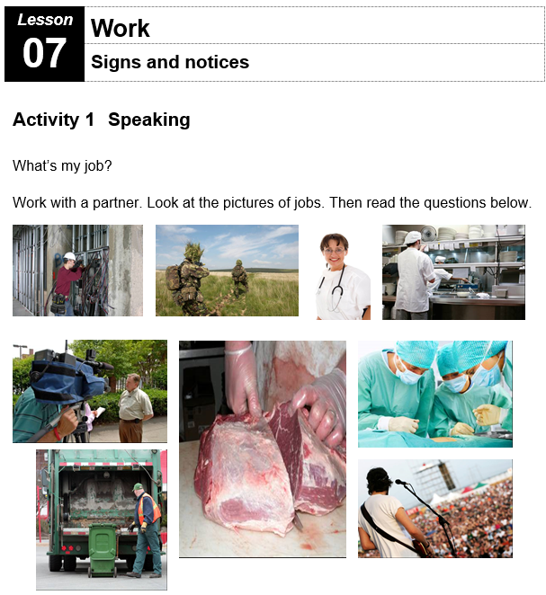
Lesson 7
Signs and Notices

Slide 2
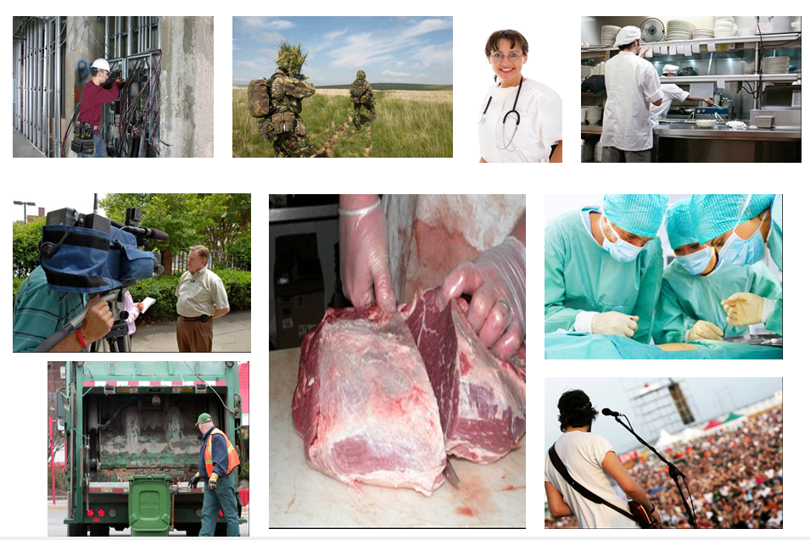
What is my job?
All photos © istockphoto.com (Top row, left to right) R Rob M Ferguson domhnall dods Matjaz Boncina Dieter Spears (Bottom left, top to bottom) David H. Lewis Mike Clarke (Middle) Greg Nicholas (Bottom right, top to bottom) Jacob Wackerhausen Jovana Cetkovic

Slide 3



Activity 2 - Reading
True
False
False

Slide 4


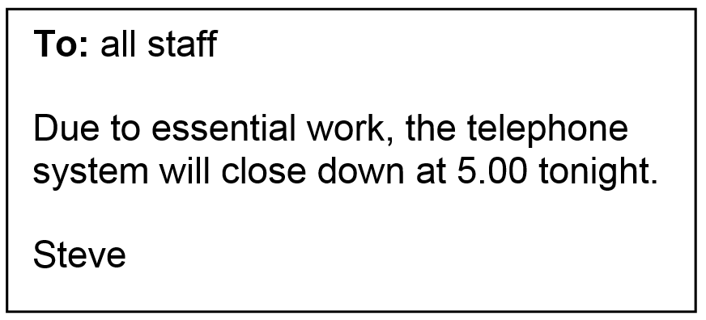
Activity 2 - Reading
True
True
True

Slide 5
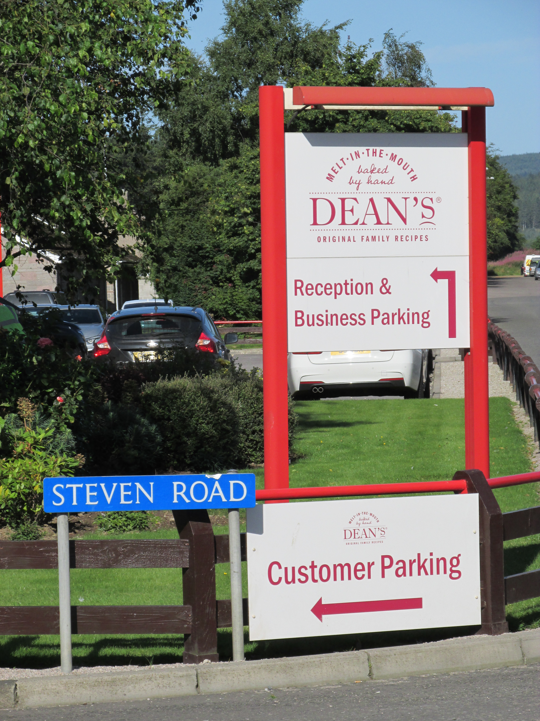
Signs in Huntly

Slide 6
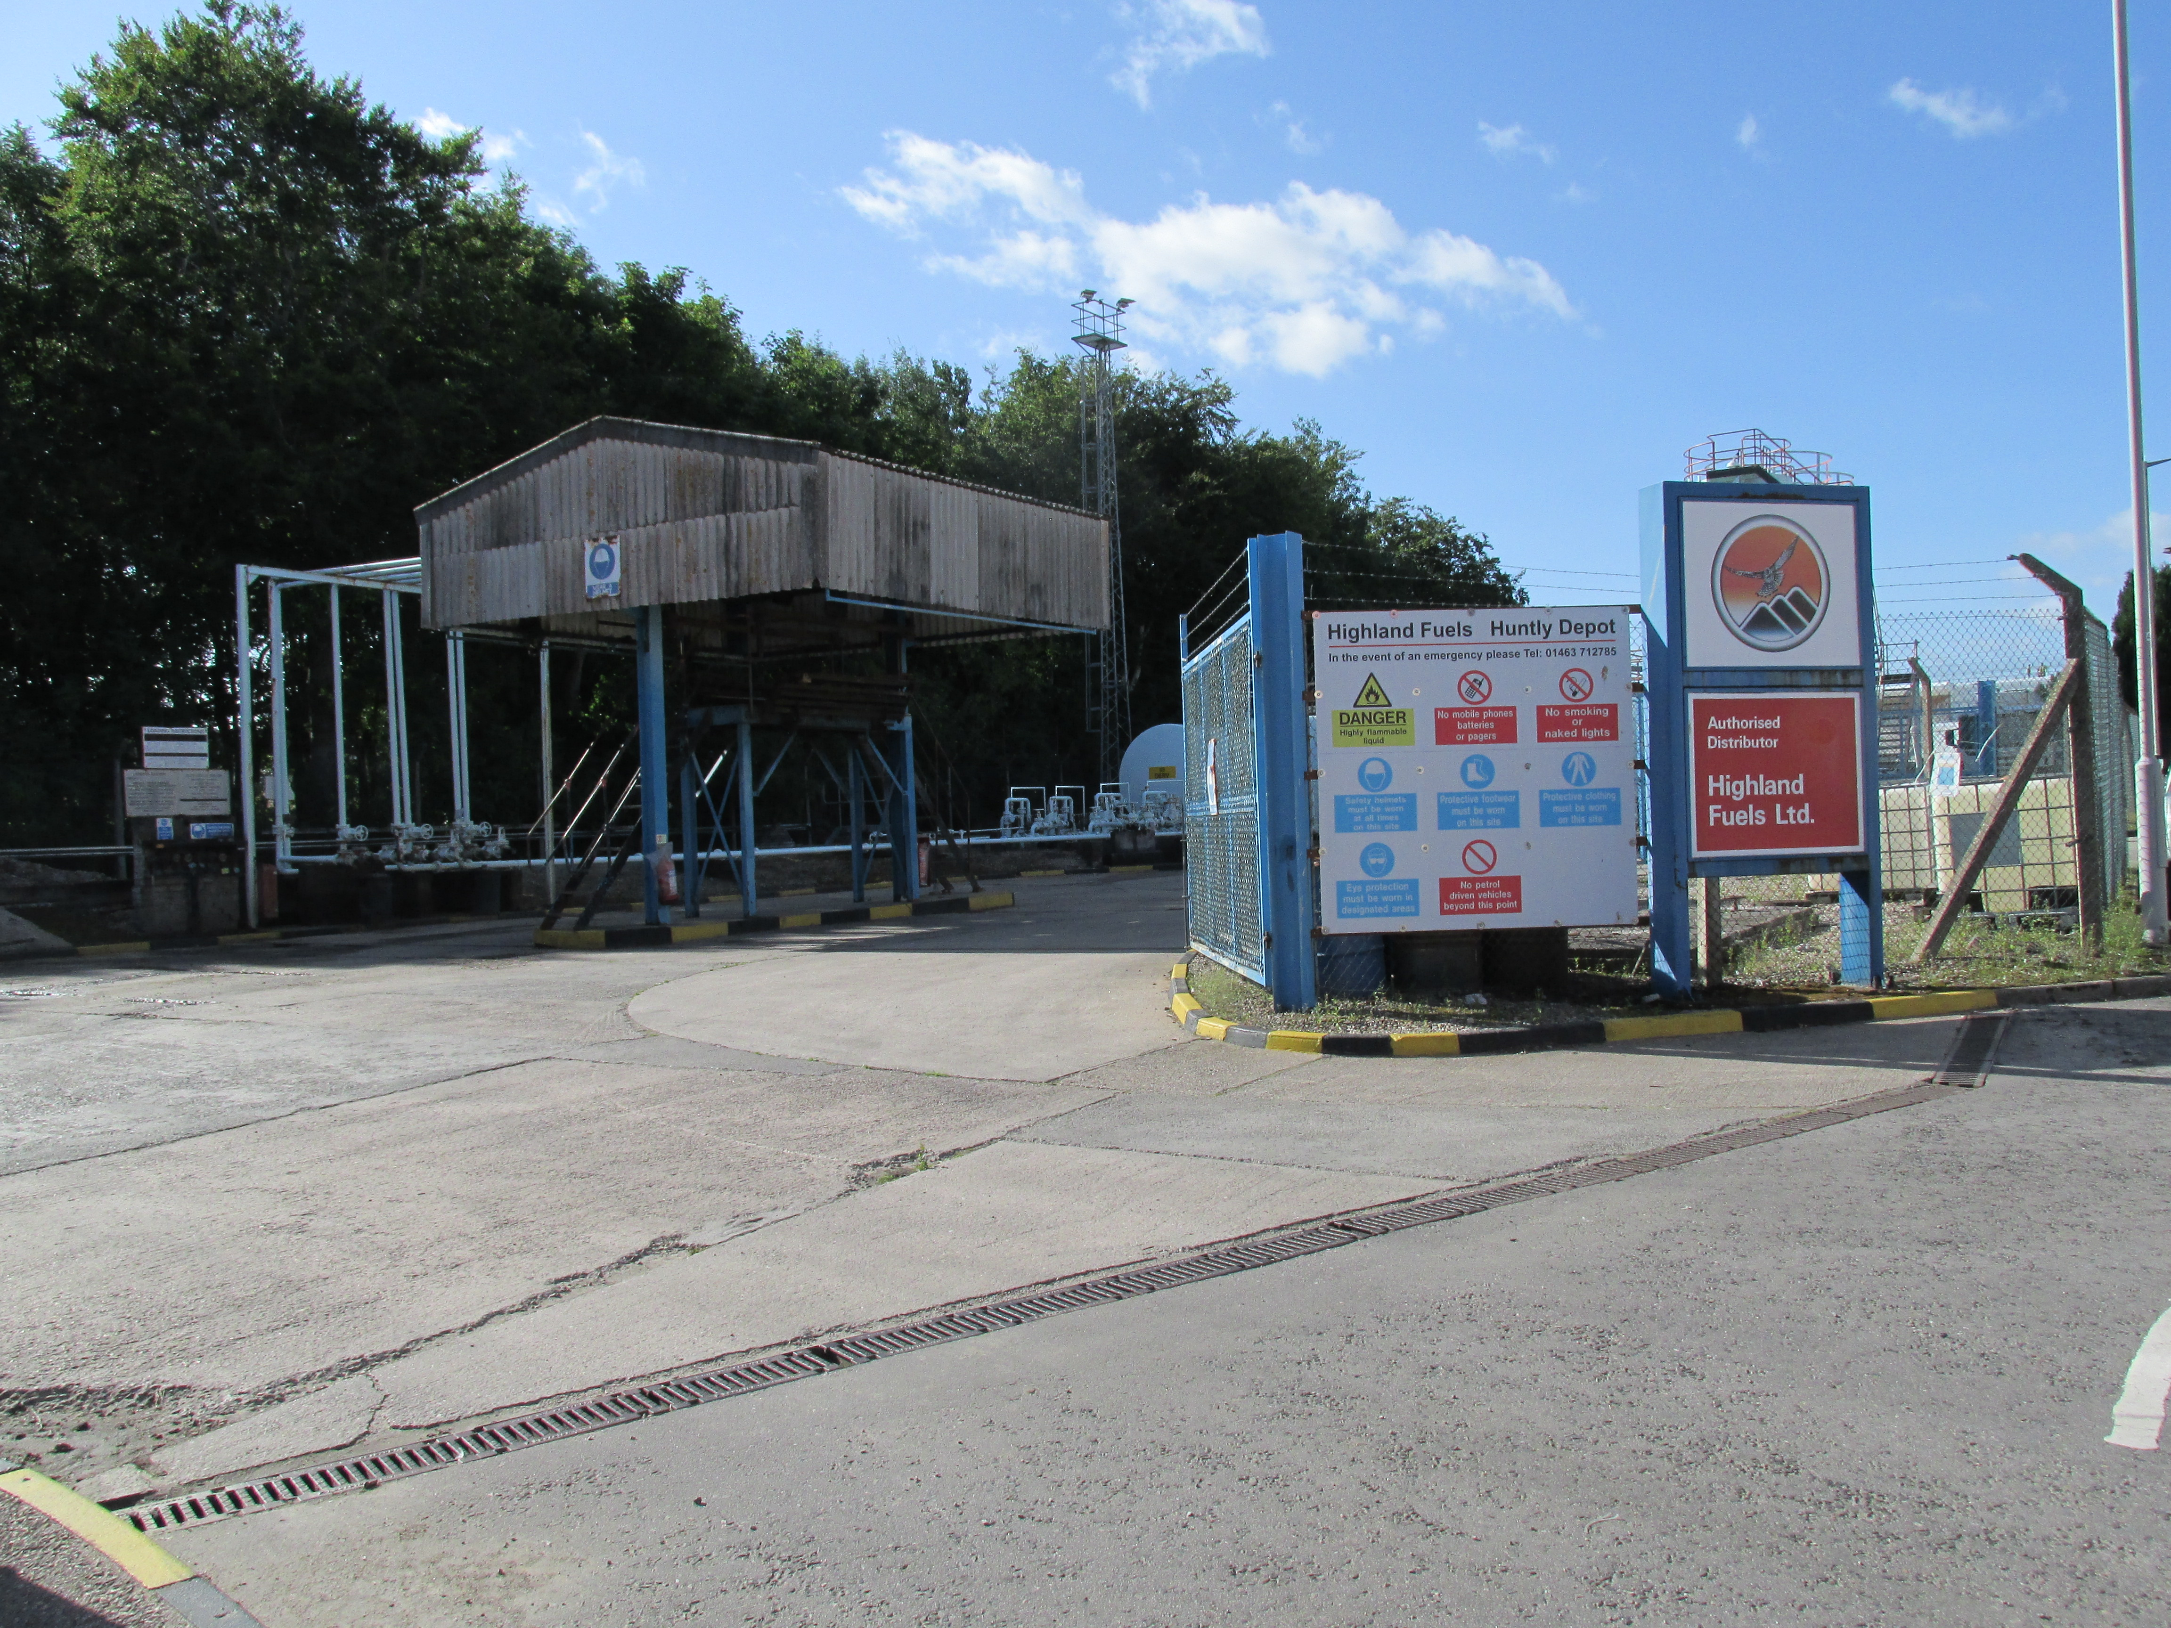

Slide 7
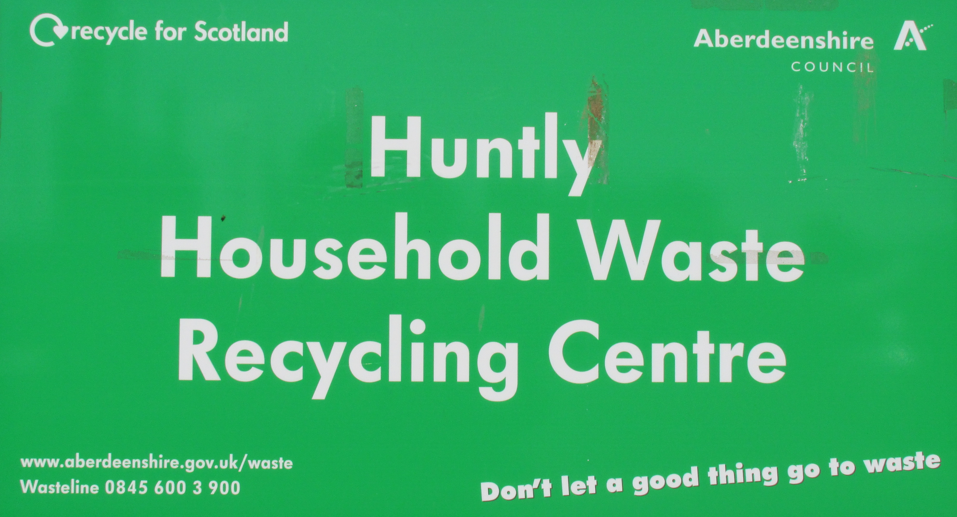
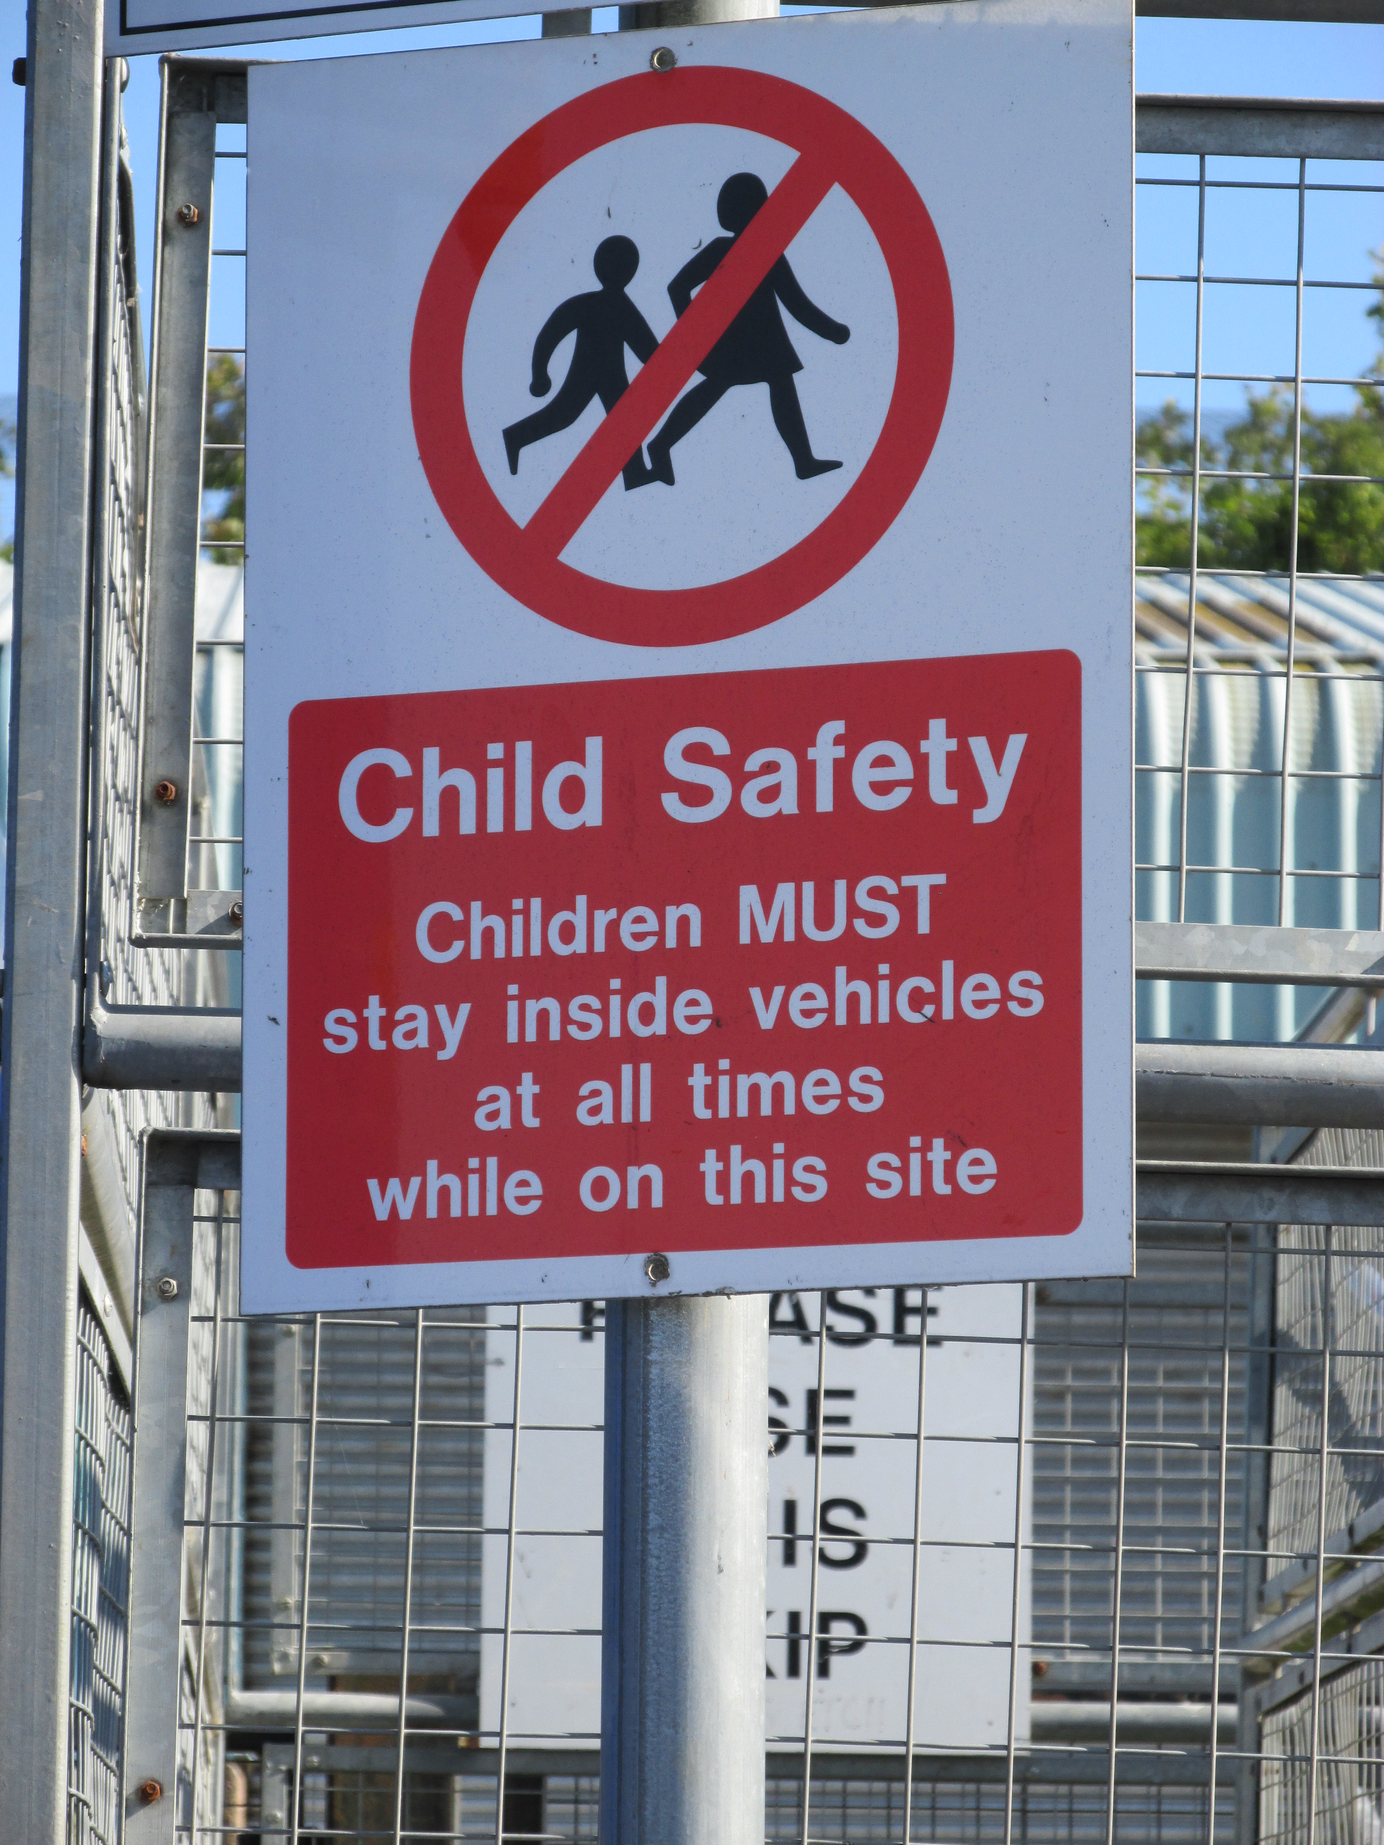
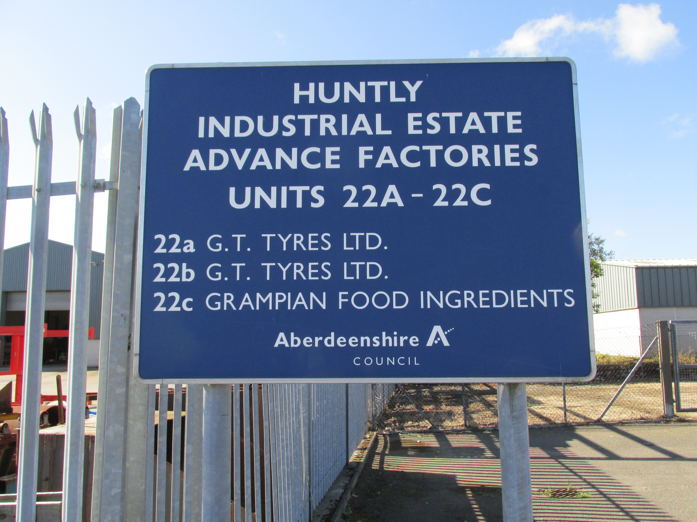

Slide 8
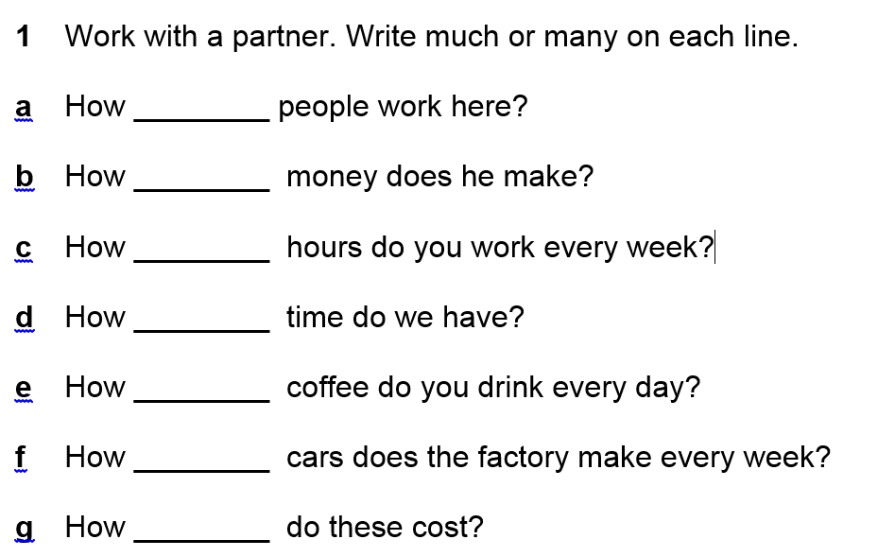

How much or how many?
Activity 3 – Language Focus
many
much
many
much
much
many
much
many

Slide 9

Activity 3 – Language Focus

Slide 10
eggs / rice / cupcakes / chocolate / cheese / pasta
Activity 3 – Language Focus

Slide 11
rice
cheese
eggs
chocolate
pasta
cupcakes

Slide 12
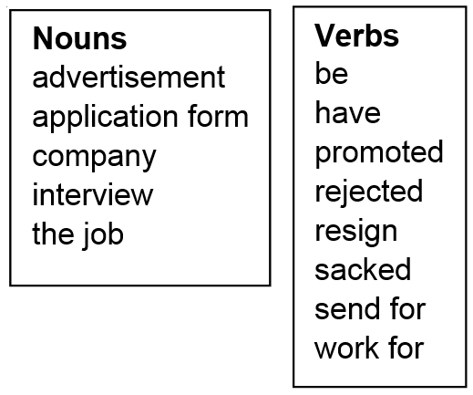
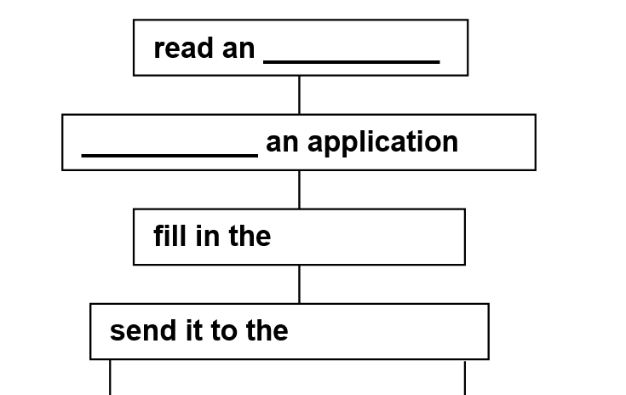
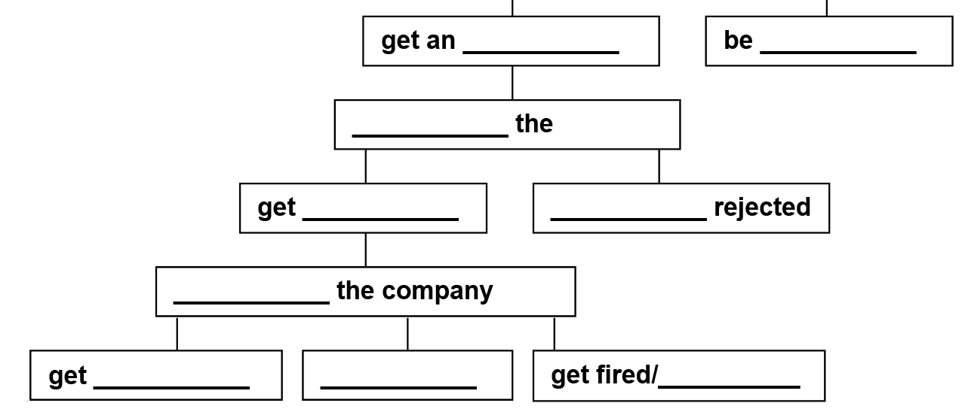
advertisement
send for
application form
company
interview
rejected
have
interview
the job
be
work for
promoted
resign
sacked

Slide 13
Activity 5 - Writing
You will be given a job. Write 50 words.
where do you work?
the number of hours every week
the pay – is it low or high?
do you need qualifications?
what kind of training do you get?
what do you do every day?

Slide 14
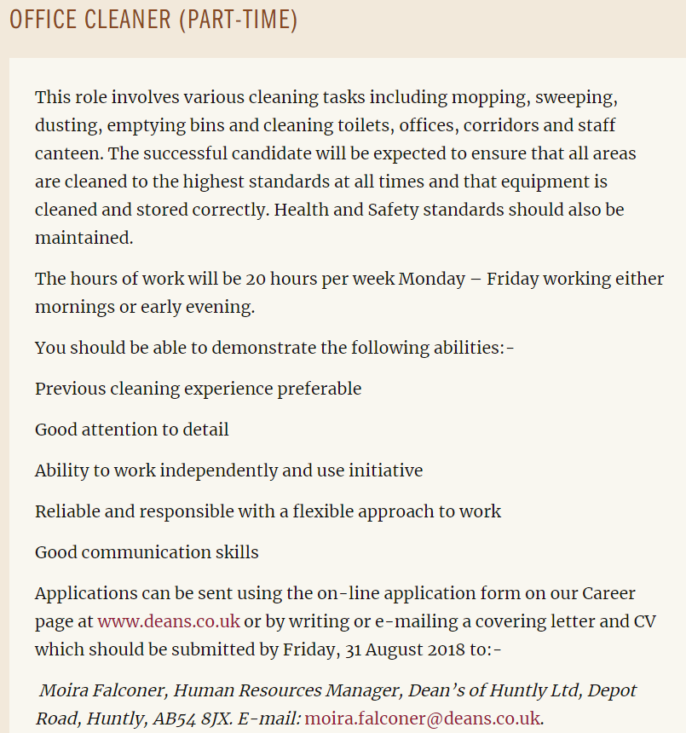

Slide 15
Homework Task
Write a final draft of your 50 word job description

Slide 16
 | Factory Operative | Office Cleaner | Staff Nurse | Early Years Practitoner | Duty Officer | Care Assistant
Where? | Dean’s | Dean’s | Insch Hospital |  |  | Huntly
Hours/week | Full time | 20 hours | 37.5 |  |  | 12 hrs
Pay £/hr |  | £7.70 | £444 week £11.90 hr |  |  | £115 week £9.58 hr
Qualifications
Training?
Job Description

Slide 17
 | Factory Operative | Office Cleaner | Staff Nurse | Early Years Practitoner | Duty Officer | Care Assistant
Where? | Dean’s | Dean’s | Insch Hospital | Gordon Primary | Huntly Pool | Meadows Huntly
Hours/week | Full time 37 hrs | Part time 20 hrs | Full time 37.5 hrs | Full time 36.25 hrs | Part time 20.25 hrs | Part time 33 hrs
Pay £/hr | £7.83 ? | £7.83 ? | £11.90 to £15.40 | £13.50 £14.63 | £11.33 £11.85 | £8.75
Qualifications | Food processing experience | No | Registered Nurse (Adults) | HND | Lifeguard First Aid | Standard Grades /Nat 4
Training? | Yes | No | Yes | Yes | Yes | Yes
Job Description | Produce baked goods | Clean offices and canteen at Deans | Work in hospital | Work in school nursery | Supervisor at pool | Support Residents

Slide 18
Thank you
Slides created by Aberdeenshire Council Community Learning and Development Team.
© Scottish Qualifications Authority 2007
Please note these materials have been repurposed for the new National Qualifications - August 2015
Image Credits © istockphoto/ or © Avril Morrison as indicated.
https://www.sqa.org.uk/sqa/33695.html

