Slide 1

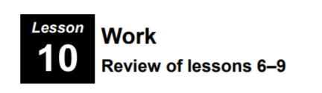
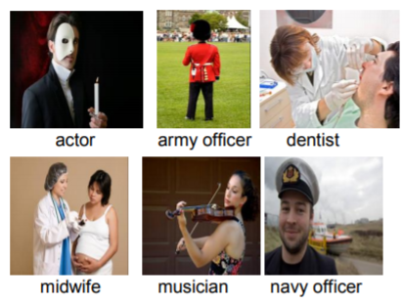
Unit 9
Understanding Texts

Slide 2
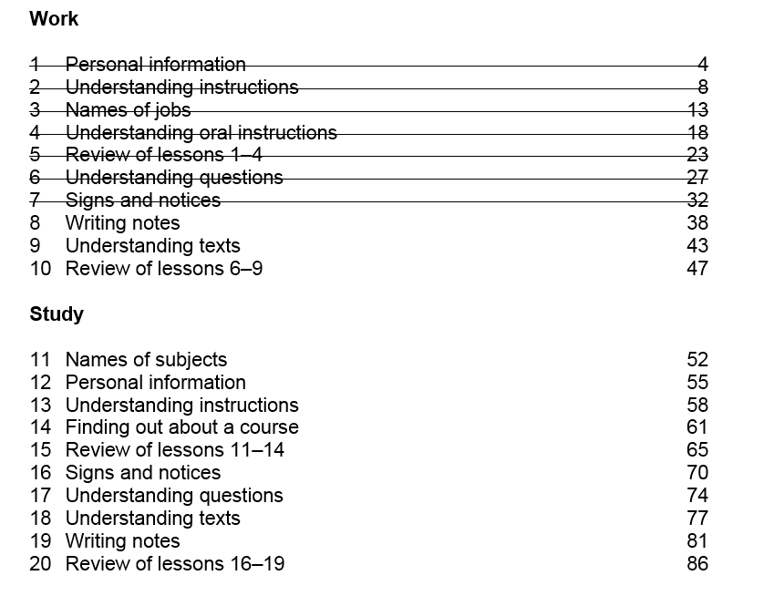

Slide 3
Unit 9 -Homework Task – Writing (50 words)
Think of a good job.
What is its name?
Why do you want it?
Will you get this job one day?

Slide 4
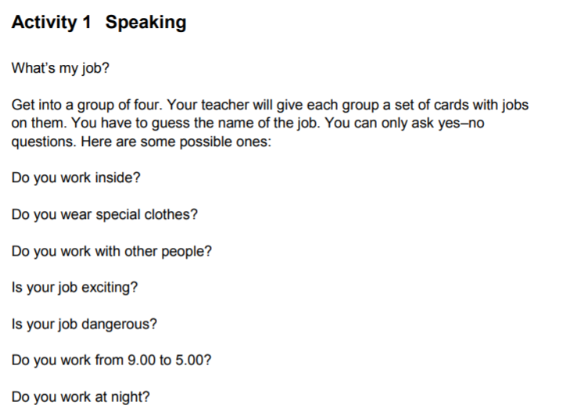
Unit 10 - Work

Slide 5

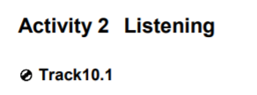
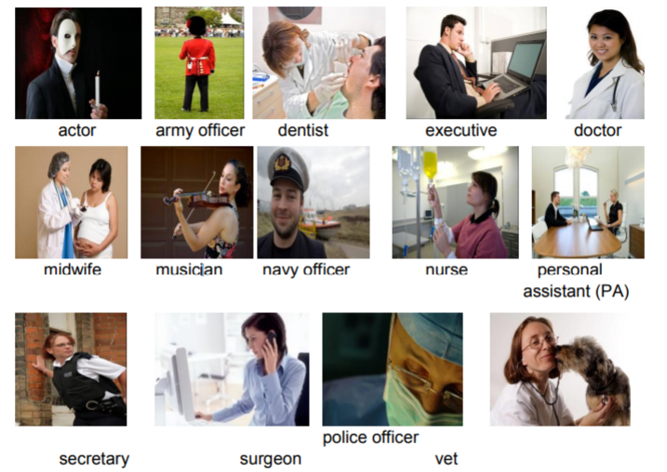
All photos © istockphoto.com (top row, left to right) eva serrabassa serega Ljupco Ed Hidden geotrac (middle row, top to bottom) Leah-Anne Thompson Karen Harrison Kuno Hamers annedde pidjoe (bottom row, left to right) Russell Du Parcq adio atbaei kkgas
police officer secretary surgeon vet

Slide 6

Activity 2 – Listening
Vet
Police Officer
Surgeon
Midwife
Personal Assistant (PA)

Slide 7
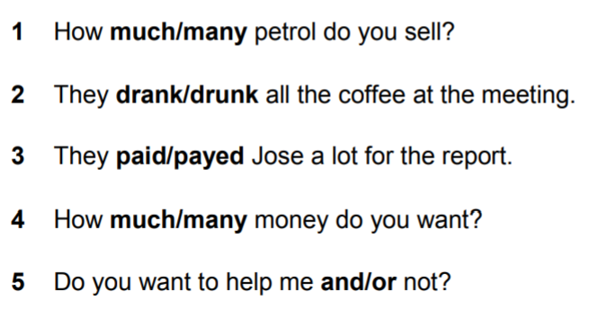
Activity 3 – Grammar
In each sentence choose one word from the two in bold

Slide 8
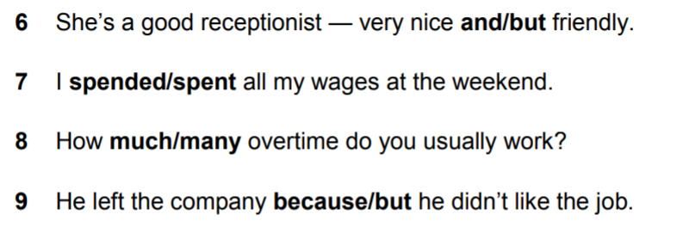
Activity 3 – Grammar
In each sentence choose one word from the two in bold

Slide 9
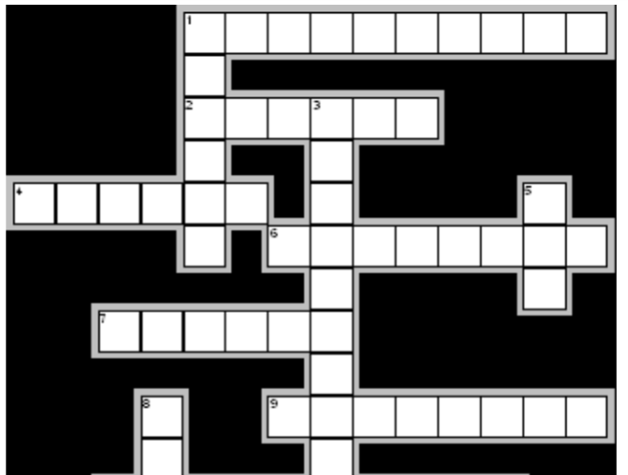
3

Slide 10
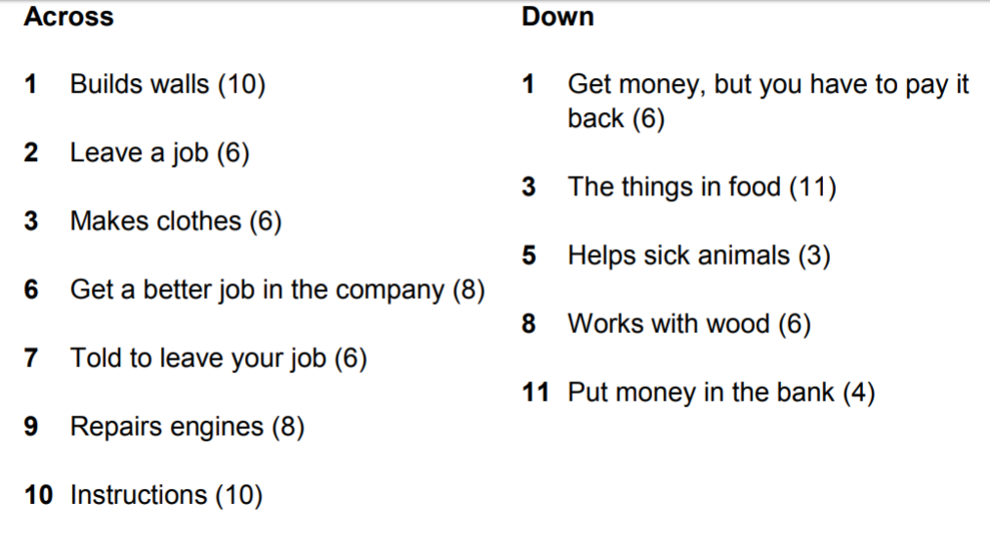

Slide 11
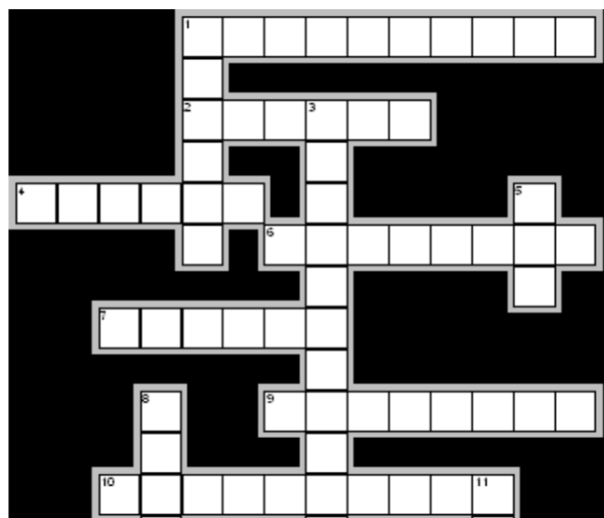













Activity 4 - Vocabulary

Slide 12
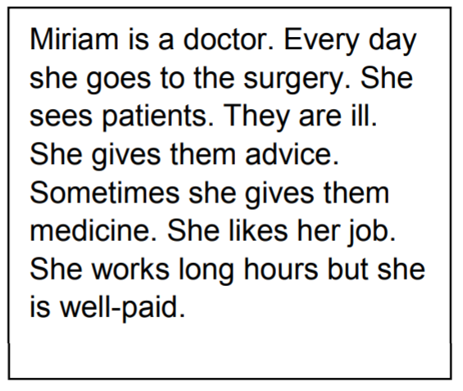
Activity 5 - Writing
Think about a job – Write about what they do every day

Slide 13
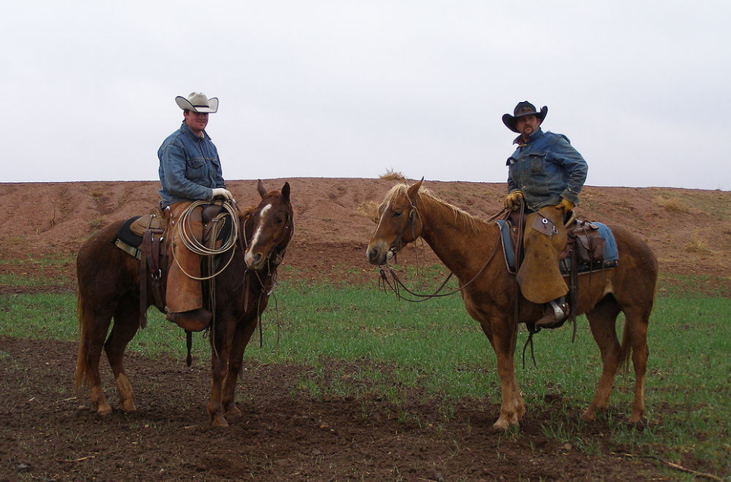
Homework Task
Jobs people don’t do in Scotland
Cowboy
Image Credit -https://commons.wikimedia.org/wiki/File:Texascowboys2.jpg

Slide 14
Thank you
Slides created by Aberdeenshire Council Community Learning and Development Team.
© Scottish Qualifications Authority 2007
Please note these materials have been repurposed for the new National Qualifications - August 2015
Image Credits © istockphoto/ or © Avril Morrison as indicated.
https://www.sqa.org.uk/sqa/33695.html

