Slide 1


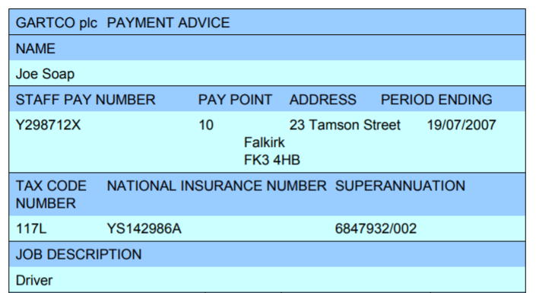
Lesson 9
Understanding Texts

Slide 2
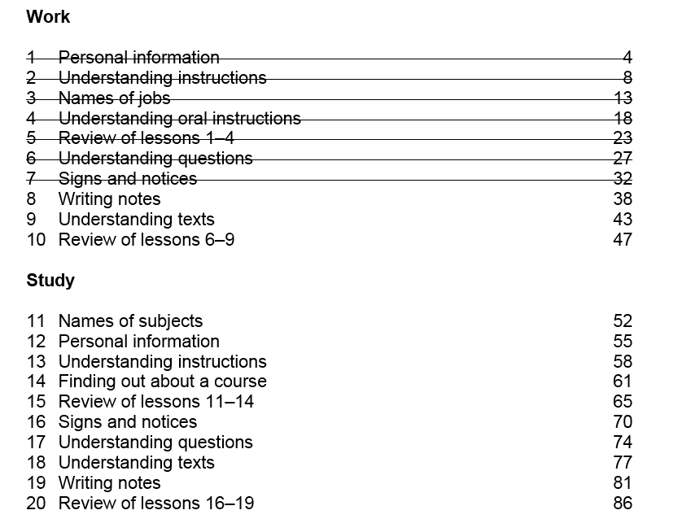

Slide 3
Unit 8 - Homework Task
Write 4 messages for colleagues at work
Hi Mel,
I’ve just gone to the shops.
Back in 10 mins
Avril
Donna,
Wendy called, Peter is sick, they won’t make it to the group today.
Avril
Dear Lada,
The IV reports are in the
cupboard in the office.
Avril
Hi Lynne,
Sorry, I’ve used the last box of
paper in the stationary cupboard.
Could you order more please?
Thanks
Avril

Slide 5
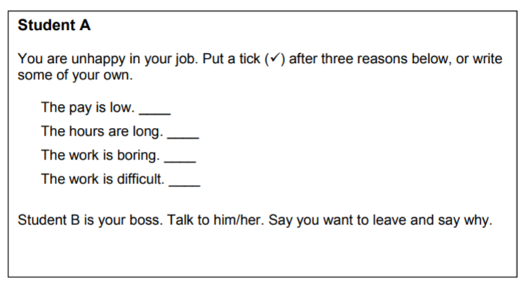
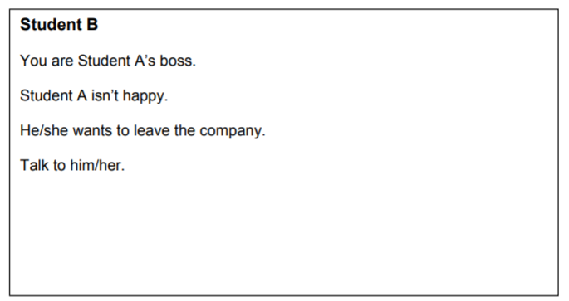
Activity 1 – Speaking - Leaving your Job

Slide 6
Activity 1 – Speaking - Responding to bad news at work
Oh dear!
That’s a shame.
I’m sorry to hear that.
I’m sorry you are not happy / I’m sorry you feel that way.
I understand your concerns.

Slide 7
Gross Pay
- total money (on job advert)
Net Pay
- money in your bank (£)
Superannuation / Pension
- Retirement

Slide 8
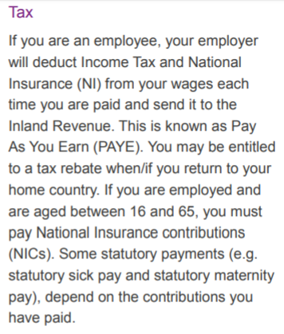
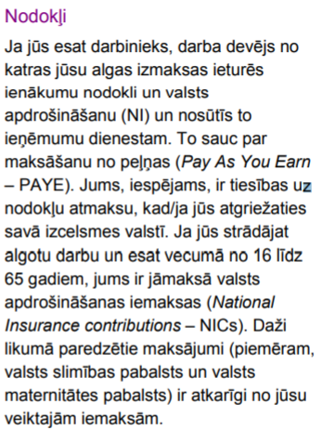
https://acceal.org.uk/living-and-working-in-ne-scotland/

Slide 9
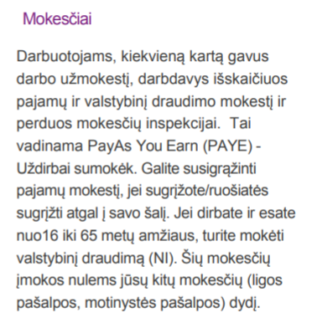
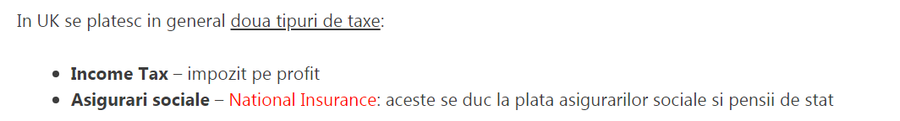
https://acceal.org.uk/living-and-working-in-ne-scotland/

Slide 10
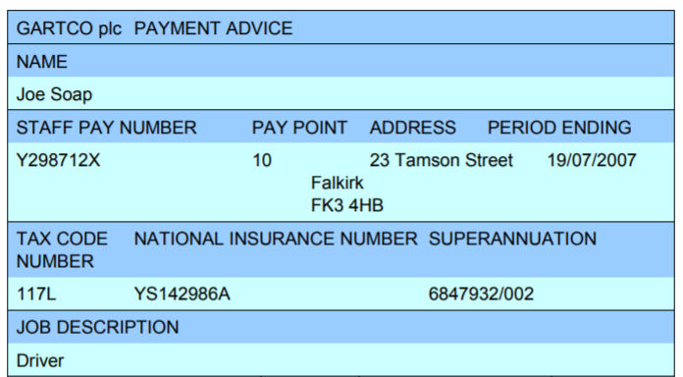
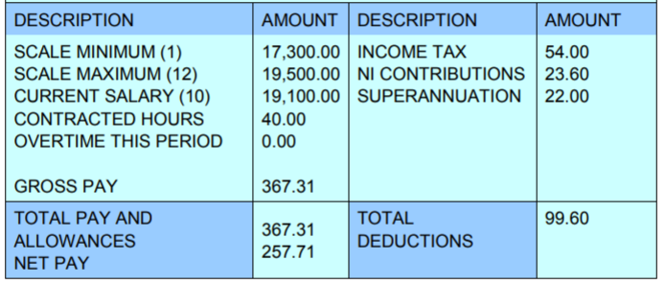

Slide 11
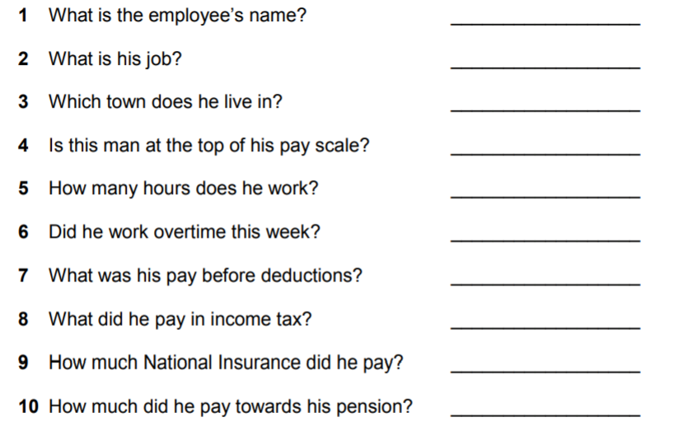
Joe
Driver
Falkirk
Nearly!
40 hours (per week)
No
£367.31
£54.00
£23.60
£22.00
£267.71

Slide 12
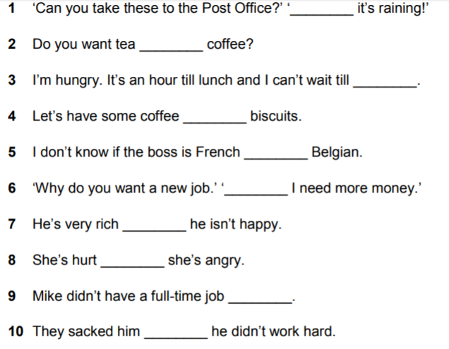
Activity 3 – Grammar
but
or
then
and
or
because
but
and
then
because

Slide 13
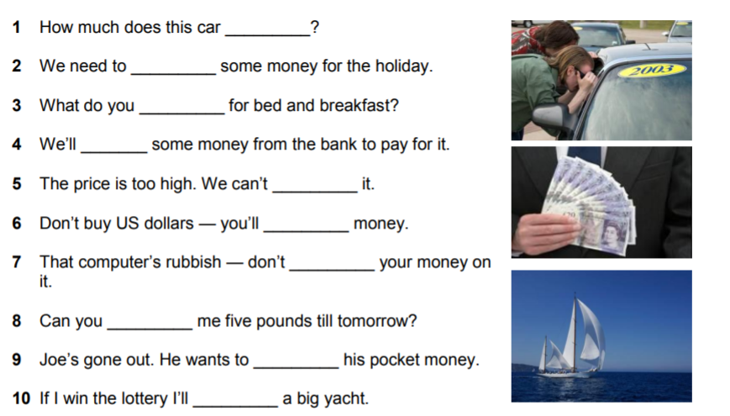

Activity 4 - Vocabulary
cost
save
charge
borrow
afford
lose
waste
lend
spend
buy

Slide 14
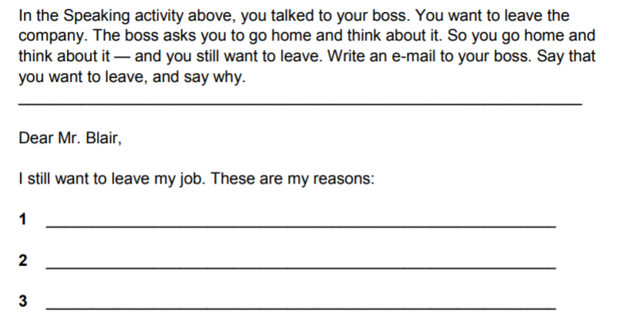
Activity 5 – Writing

Slide 15
Unit 9 -Homework Task – Writing (50 words)
Think of a good job.
What is its name?
Why do you want it?
Will you get this job one day?

Slide 16
Thank you
Slides created by Aberdeenshire Council Community Learning and Development Team.
© Scottish Qualifications Authority 2007
Please note these materials have been repurposed for the new National Qualifications - August 2015
Image Credits © istockphoto/ or © Avril Morrison as indicated.
https://www.sqa.org.uk/sqa/33695.html

