Slide 1

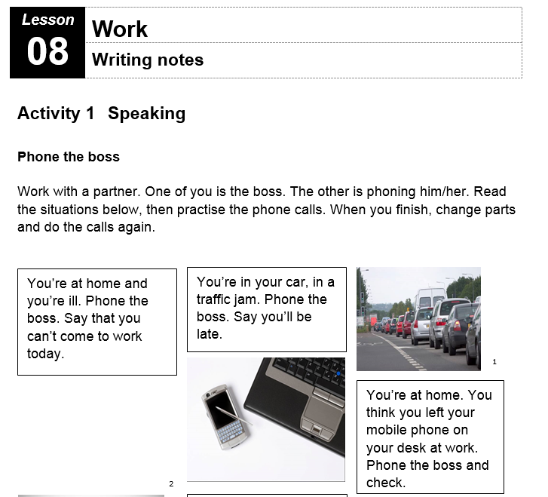
Lesson 8
Writing Notes

Slide 2
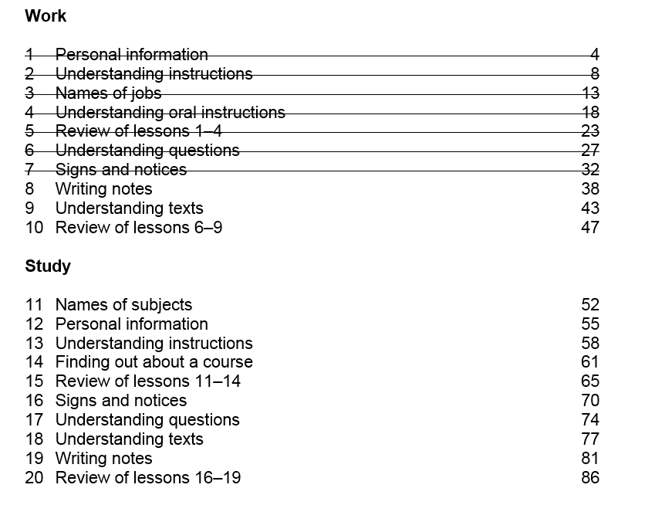

Slide 3
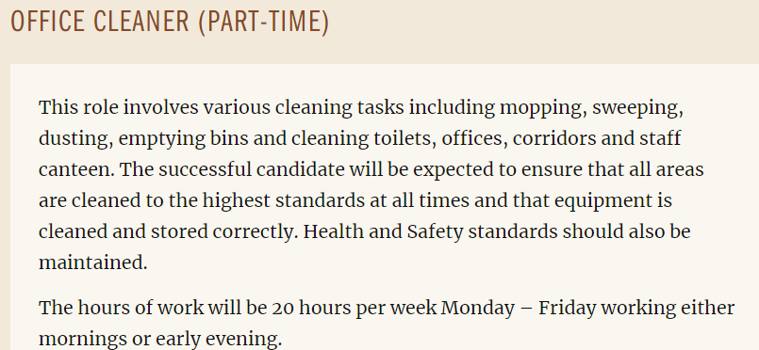
Unit 7 - Homework Task
Write a final draft of your 50 word job description

Slide 5
 | Factory Operative | Office Cleaner | Staff Nurse | Early Years Practitoner | Duty Officer | Care Assistant
Where? | Dean’s | Dean’s | Insch Hospital |  |  | Huntly
Hours/week | Full time | 20 hours | 37.5 |  |  | 12 hrs
Pay £/hr |  | £7.70 | £444 week £11.90 hr |  |  | £115 week £9.58 hr
Qualifications
Training?
Job Description

Slide 6
 | Factory Operative | Office Cleaner | Staff Nurse | Early Years Practitoner | Duty Officer | Care Assistant
Where? | Dean’s | Dean’s | Insch Hospital | Gordon Primary | Huntly Pool | Meadows Huntly
Hours/week | Full time 37 hrs | Part time 20 hrs | Full time 37.5 hrs | Full time 36.25 hrs | Part time 20.25 hrs | Part time 33 hrs
Pay £/hr | £7.83 ? | £7.83 ? | £11.90 to £15.40 | £13.50 £14.63 | £11.33 £11.85 | £8.75
Qualifications | Food processing experience | No | Registered Nurse (Adults) | HND | Lifeguard First Aid | Standard Grades /Nat 4
Training? | Yes | No | Yes | Yes | Yes | Yes
Job Description | Produce baked goods | Clean offices and canteen at Deans | Work in hospital | Work in school nursery | Supervisor at pool | Support Residents

Slide 7
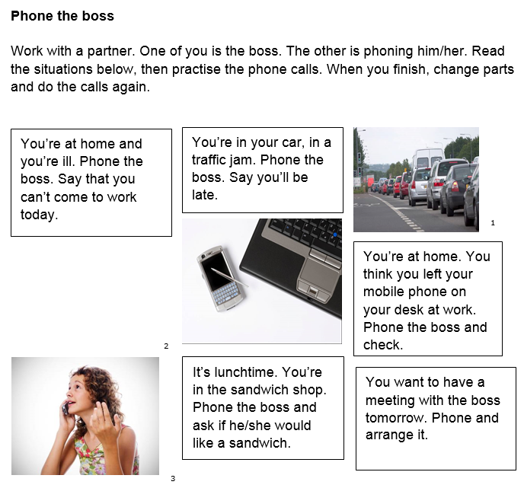
Activity 1 – Speaking - Phone the Boss
All photos © istockphoto.com 1 Rob Hill 2 Matjaz Boncina 3 Joan Vicent Canto Roig

Slide 8

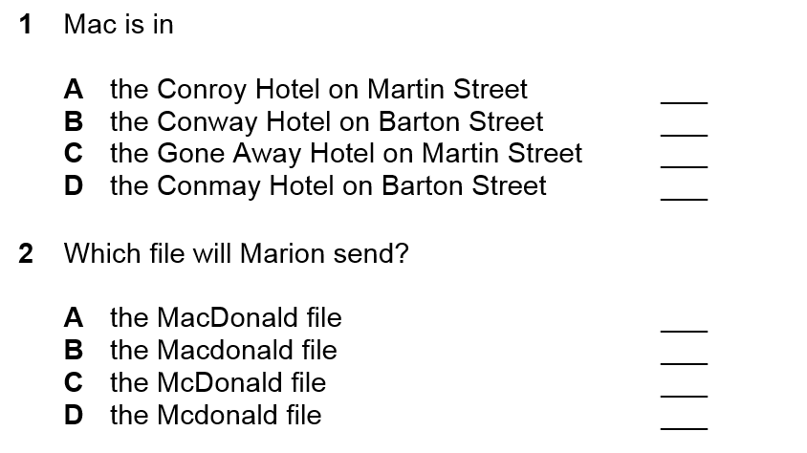
Activity 2 -Listening
✓
✓

Slide 9
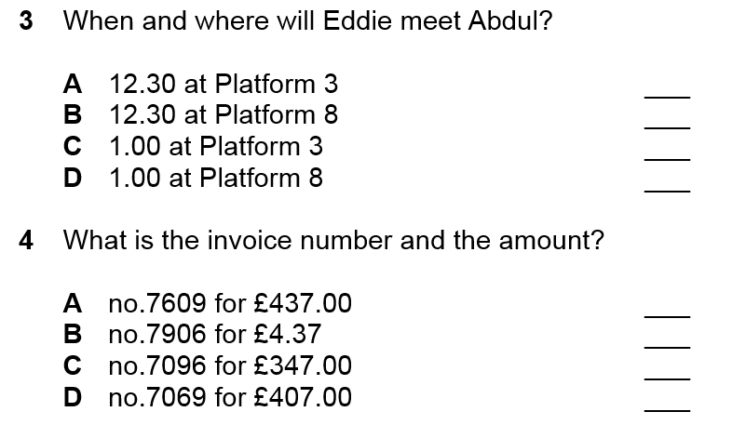
Activity 2 -Listening
(36 sec)
✓
(52 sec)
✓

Slide 10

Activity 2 -Listening
(1 min 08 sec)
✓


Slide 11
Activity 3 –Language Focus
Verbs in the past tense
work
meet
forget
walk
fly
play
lose

Slide 12
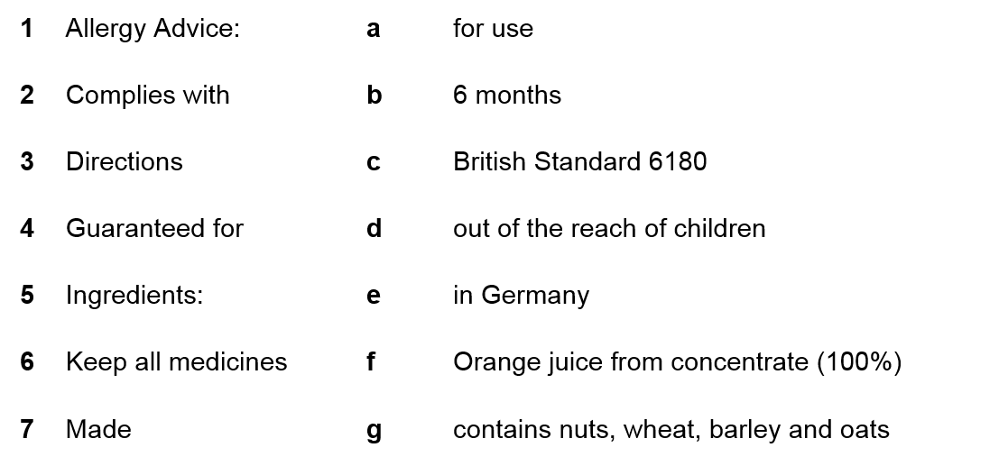
Activity 4 –Product Information

Slide 13
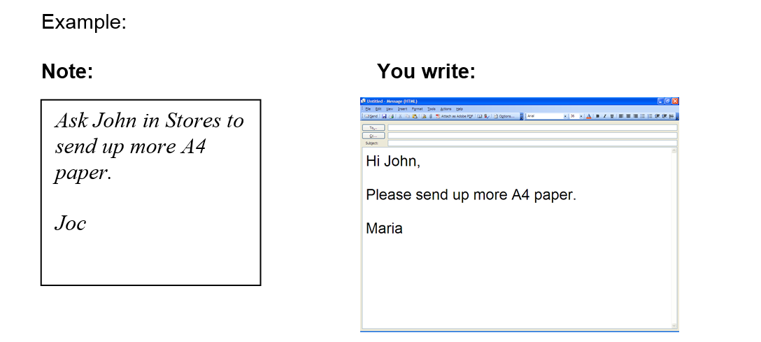
Activity 5 - Writing
Avril

Slide 14
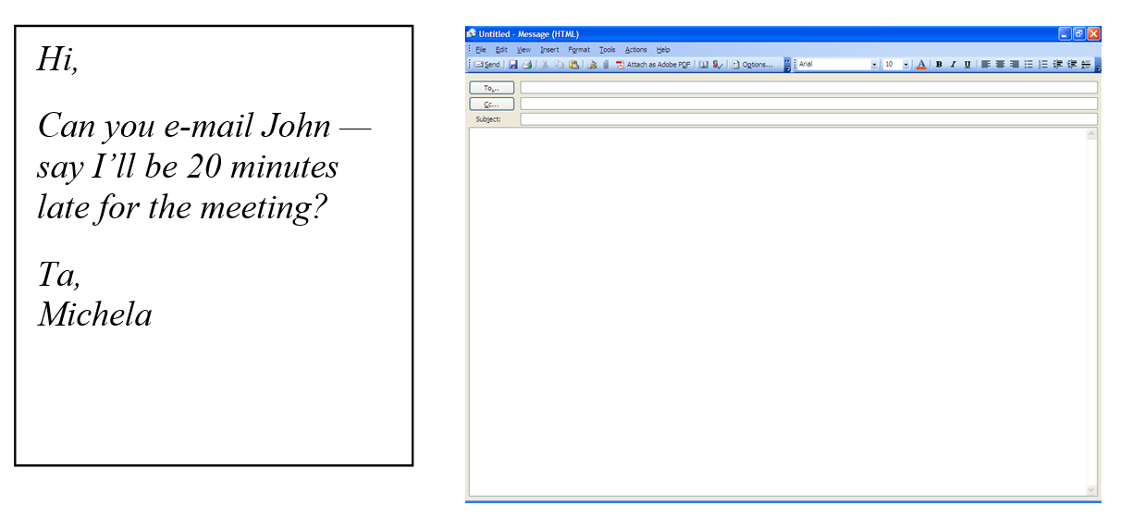
Dear John,
Michela will be 20 minutes
late for the meeting.
Avril

Slide 15
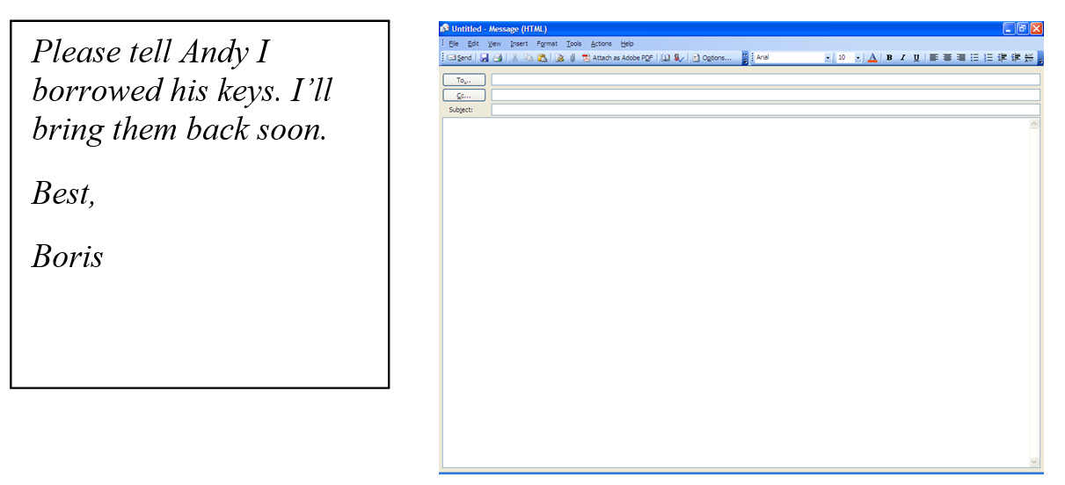
Dear Andy,
Boris borrowed your keys.
He’ll bring them back soon.
Avril

Slide 16
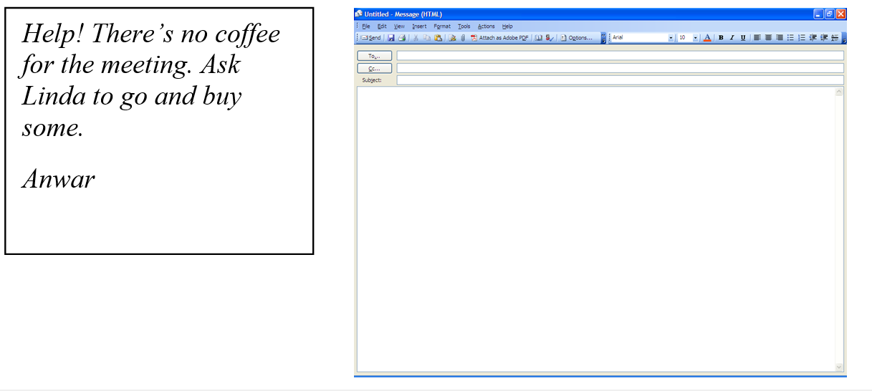
Dear Linda,
Can you buy coffee for Anwar’s meeting?
Avril

Slide 17
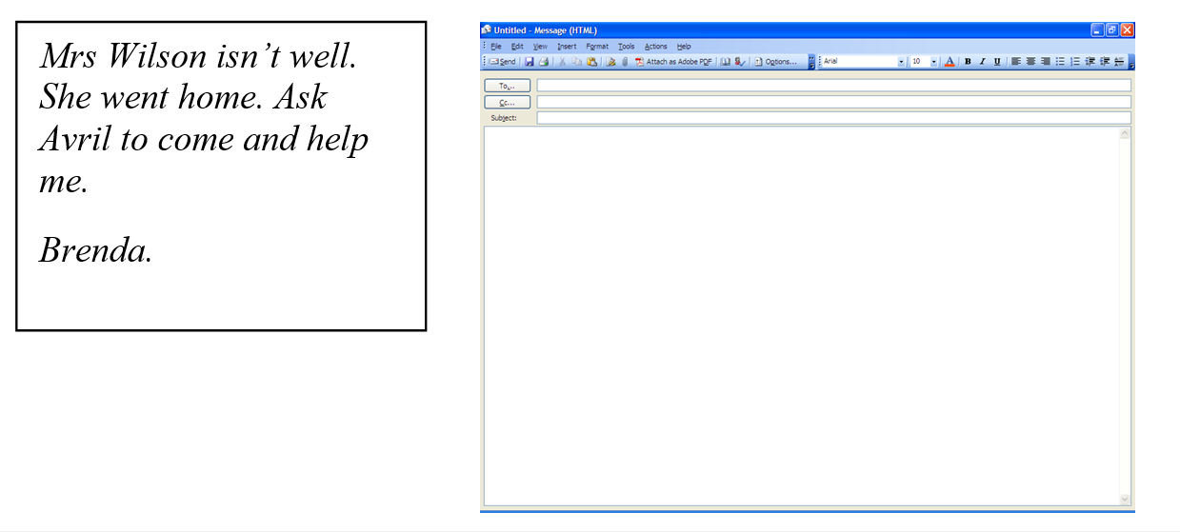
Dear Avril,
Can you help Brenda?
Mrs Wilson isn’t well.

Slide 18
Write 4 messages for colleagues at work
Unit 8 – Homework Task

Slide 19

Thank you
Slides created by Aberdeenshire Council Community Learning and Development Team.
© Scottish Qualifications Authority 2007
Please note these materials have been repurposed for the new National Qualifications - August 2015
Image Credits © istockphoto/ or © Avril Morrison as indicated.
https://www.sqa.org.uk/sqa/33695.html

