Slide 1

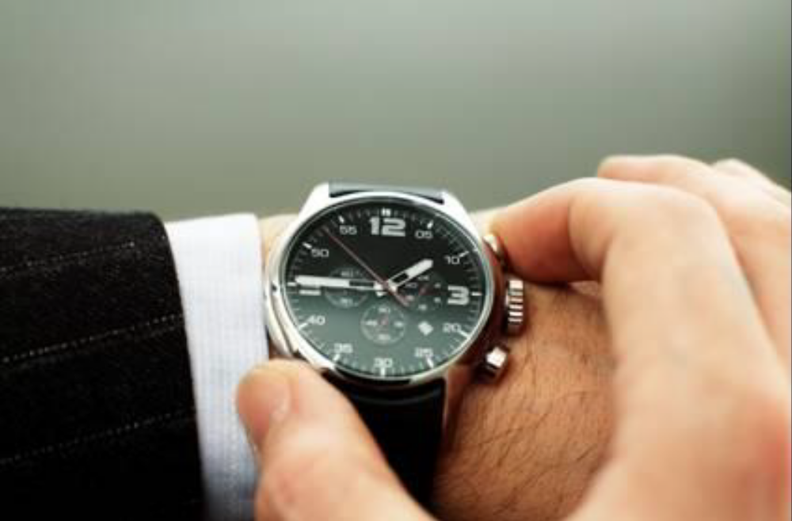
Lesson 6
Work
Lesson
06
Work
Understanding Questions
Understanding Questions

Slide 2
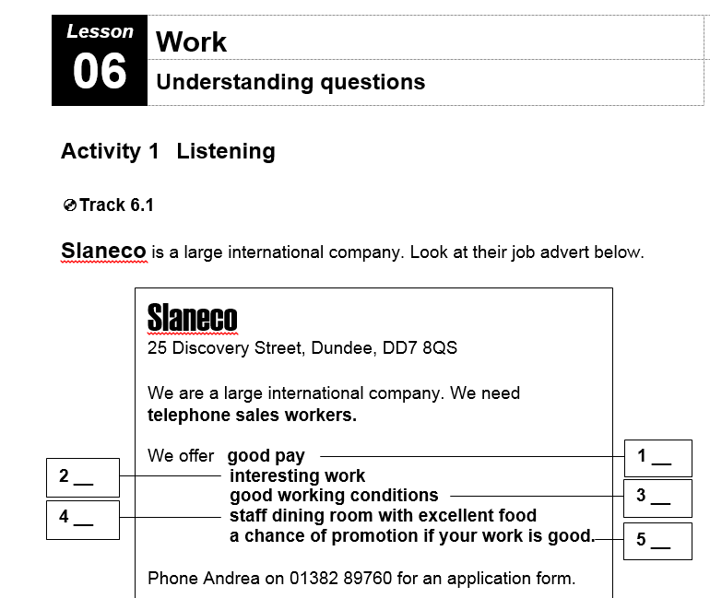
ESOL in Context for Work and Study
Lesson 6 – Understanding Questions

Slide 3
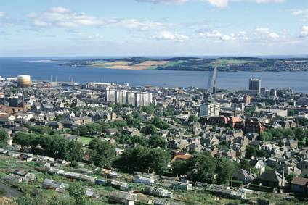
Where is this?

Slide 4
Lesson 6 – Understanding Questions
In any language you…
1 Ask Questions
2 Answer Questions
3 Make statements

Slide 5
In English there are 3 types of question.
Is your name Avril?
1 Yes / No questions
2 Questions with “or”
Are you Avril or Lada?
3 Wh- questions
What’s your name?

Slide 6
Ask me a yes/ no question.

Slide 7
Activity 2 – Language Focus
Is your name Avril?
What’s your name?
Your name’s Avril?
Yes/no question
We change the word order:
1 2 3
Your name is …
3 1 2
Is your name …?
We can answer with
‘Yes.’ or ‘No.’
Wh- question
We start with a question word — what. Then we change the word order.
1 2 3
Your name is …
0 3 1 2
What’s your name …?
When we answer, we give some information:
‘Avril.’
Checking question
We don’t change the word order:
1 2 3
Your name’s Avril.
1 2 3
Your name’s Avril?
but our voice rises at the end:
Your name’s Boris?
We use this when we think we know the answer. Usually, this is:
‘Yes.’

Slide 8
Yes/ no questions.
The first word in a yes no question is ALWAYS a verb
3 1 2
Is your name …?
3 1 2
Do you like the food?
3 1 2
Are you happy here?

Slide 9
 | Yes/no question | Wh- question | Checking question
1 You started work here six months ago? | ______ | ______ | ______
2 That was in May? | ______ | ______ | ______
3 So, why did you choose Slaneco? | ______ | ______ | ______
4 Did you think Slaneco was a good company? | ______ | ______ | ______
5 Now, are you happy here? | ______ | ______ | ______
6 Why aren’t you happy? | ______ | ______ | ______
7 But you like the working conditions? | ______ | ______ | ______
8 You mean the canteen? | ______ | ______ | ______
9 You don’t like the food? | ______ | ______ | ______
10 Is the pay better? | ______ | ______ | ______
11 And the work is not so boring? | ______ | ______ | ______
12 So, do you want the job? | ______ | ______ | ______

Slide 10
 | Yes/no question | Wh- question | Checking question
1 You started work here six months ago? | ______ | ______ | __✓
2 That was in May? | ______ | ______ | ___✓
3 So, why did you choose Slaneco? | ______ | __✓ | ______
4 Did you think Slaneco was a good company? | __✓ | ______ | ______
5 Now, are you happy here? | __✓ | ______ | ______
6 Why aren’t you happy? | ______ | ___✓ | ______
7 But you like the working conditions? | ___✓ | ______ | ______
8 You mean the canteen? | ______ | ______ | ___✓
9 You don’t like the food? | ______ | ______ | ___✓
10 Is the pay better? | ___✓ | ______ | ______
11 And the work is not so boring? | ______ | ______ | ___✓
12 So, do you want the job? | ___✓ | ______ | ______

Slide 11
Activity 3 - Speaking
Avril Jenny Points
‘Your name’s Jenny?’ ‘Yes.’ 1
‘You’re from Wales?’ ‘No.’ 0
‘Your first language is Welsh?’ ‘No — English.’ 0
‘You live near here?’ ‘Yes— quite near.’ 1
‘You like football?’ ‘No.’ 1
‘You’re married?’ ‘Yes.’ 0
__ Total: 3

Slide 12
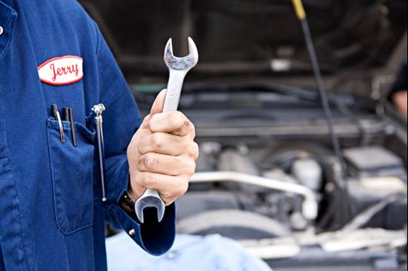
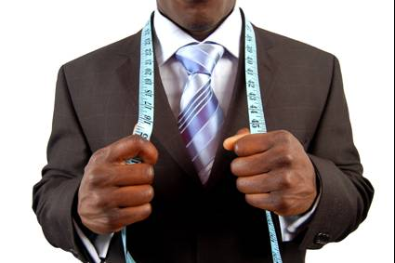
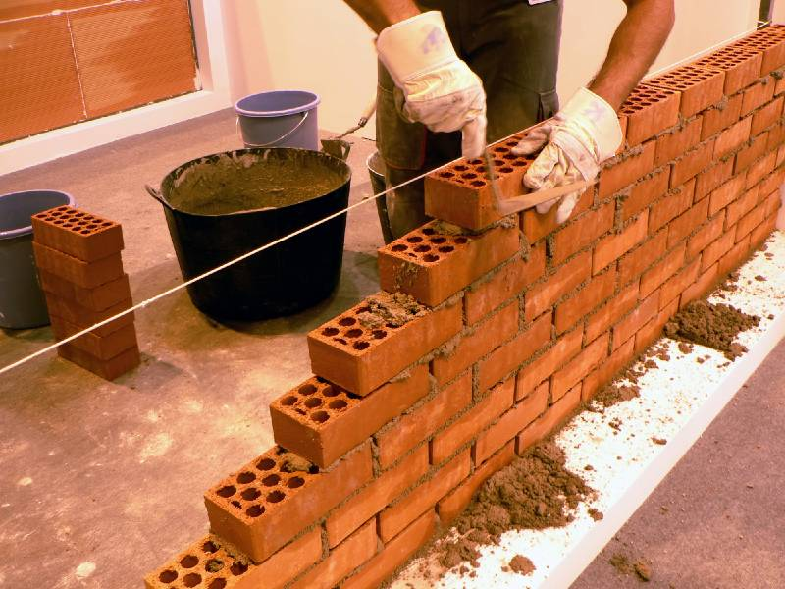
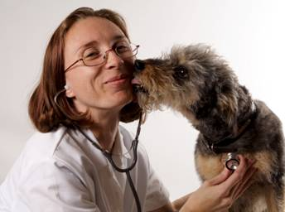
Unit 4 - Vocabulary
1 accountant a engines
2 bricklayer b babies
3 electrician c cloth
4 joiner d pipes
5 journalist e numbers
6 mechanic f wood
7 midwife g animals
8 plumber h walls
9 tailor i cables
10 vet j newspapers
1 e
h
I
f
j
a
b
d
c
g
All photos © istockphoto.com Top left – Denis Owusu-Ansah Top right – Sean Locke Bottom left – Manuel Velasco Bottom right - kkgas

Slide 13
Activity 5 - Writing
Think about the interview with Boris in the listening activity.
There were some good things about the job — a nice desk and a comfortable chair — and some bad things — the pay, the food in the canteen, etc.
Now think about your work, in school, college or employment.
Write about the good things and the bad things. Write around 50 words.
☺ / ☹

Slide 14

Homework Task
Think about some interesting jobs, some that you would like to do. Use the internet or a library, or talk to a friend or relative, to find out about each job. Write notes on the good and bad things. Here’s an example:
Midwife
Good things Bad things
you help people the pay isn’t high
the work is interesting you work at night sometimes
every day is different sometimes things go wrong with the birth

Slide 15
Thank you
Slides created by Aberdeenshire Council Community Learning and Development Team.
© Scottish Qualifications Authority 2007
Please note these materials have been repurposed for the new National Qualifications - August 2015
Image Credits © istockphoto/ or © Avril Morrison as indicated.
https://www.sqa.org.uk/sqa/33695.html

