Slide 1


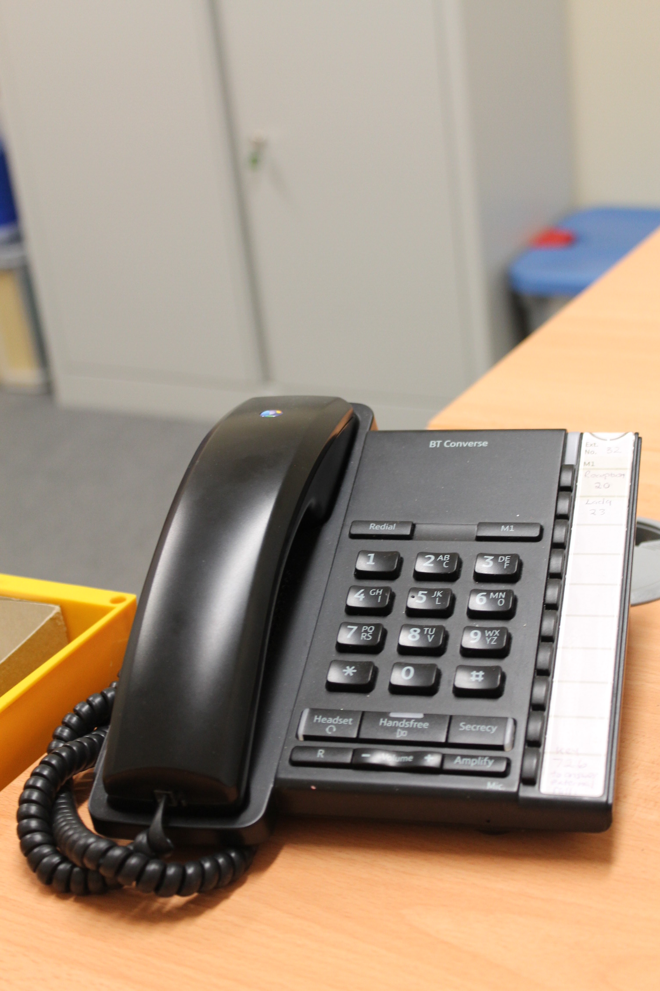
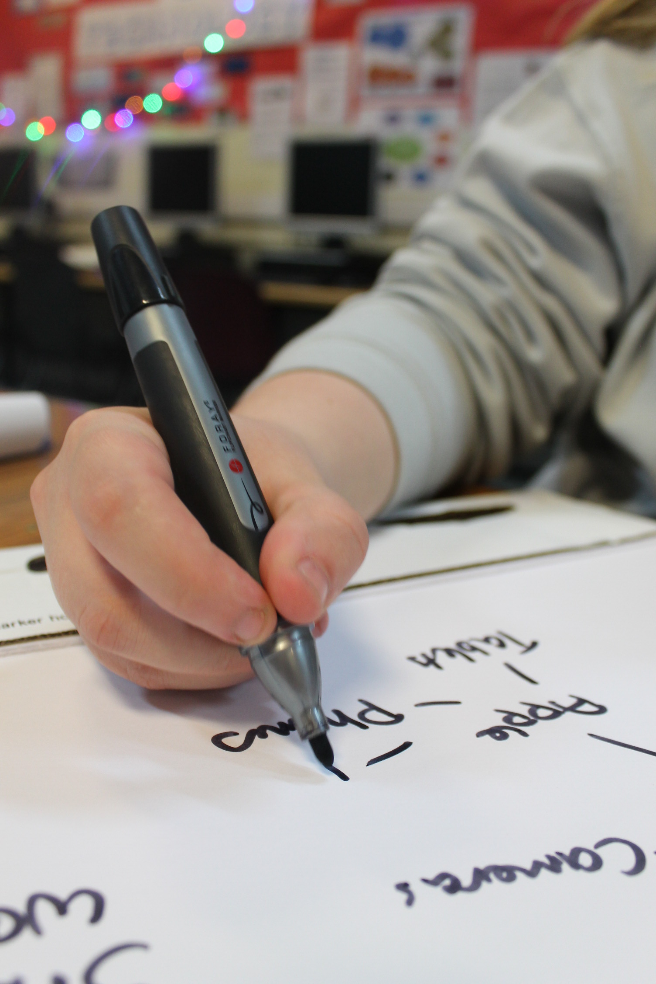
Unit 20
Review

Slide 2
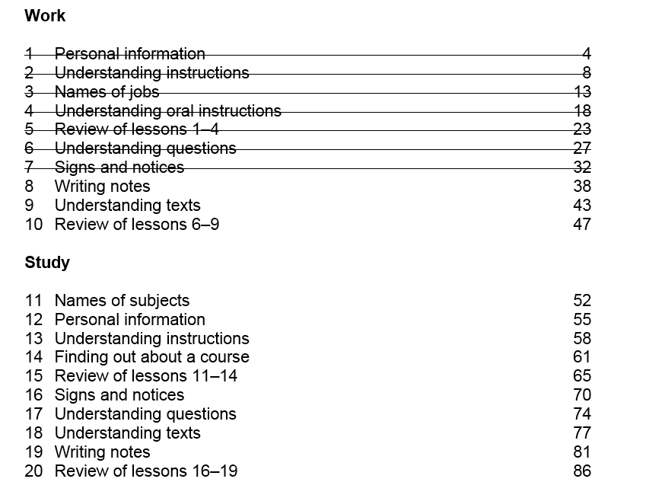

Slide 3
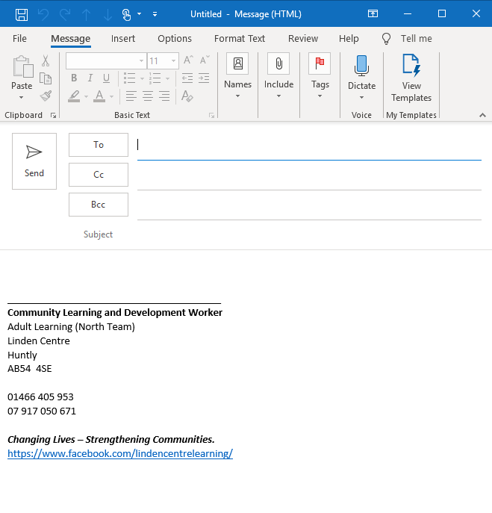
Homework Task
Write an email to your tutor. Say that you have a new address
Give your old address and your new one

Slide 4
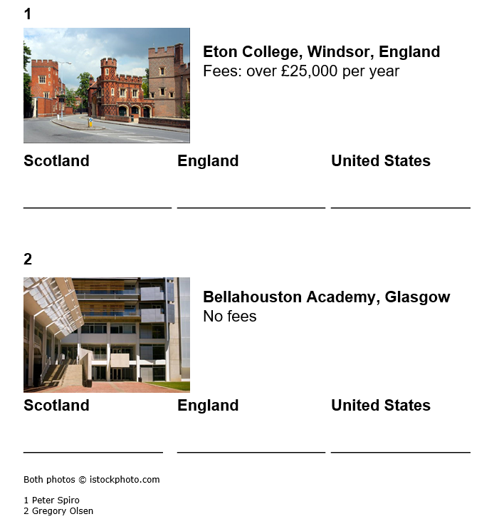

Activity 1 - Reading
Write either - Private School, Public School, State School
Private School
Public School
Private School
3
The University of California
United States
State School
State School
Public School
State School

Slide 5
Activity 2 - Speaking
Did you go to a private school?
Do you think private schools are a good idea?
For | Against
They give pupils a good education | They divide communities
They give pupils confidence | They can separate pupils from their parents
Discuss private schools with your group. Are they good or bad?

Slide 6

Activity 3 - Grammar
Circle the correct answer.
1 It’s raining hard/ hardly
2 Do you like sweets? / Would you like some sweets? “No thanks”
3 A little red book / A red little book
4 I’ll see you at / in summer
5 Do you like soup / Would you like some soup? “Yes – it smells good”
6 Carol sings very quiet / quietly
7 I have an interview ___ / in next week
8 A dirty horrible / horrible dirty dog
9 Do you like films? Would you like to watch a film?
“Yes, I watch a lot of them”
© istockphoto.com/Oliver Blondeau

Slide 7
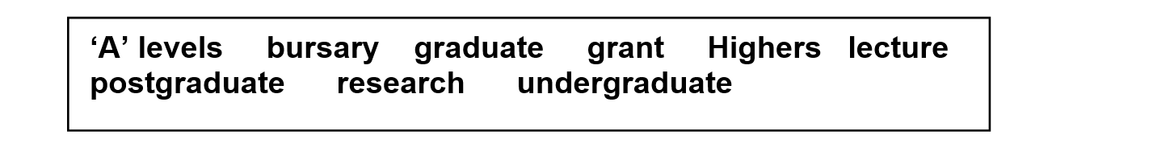
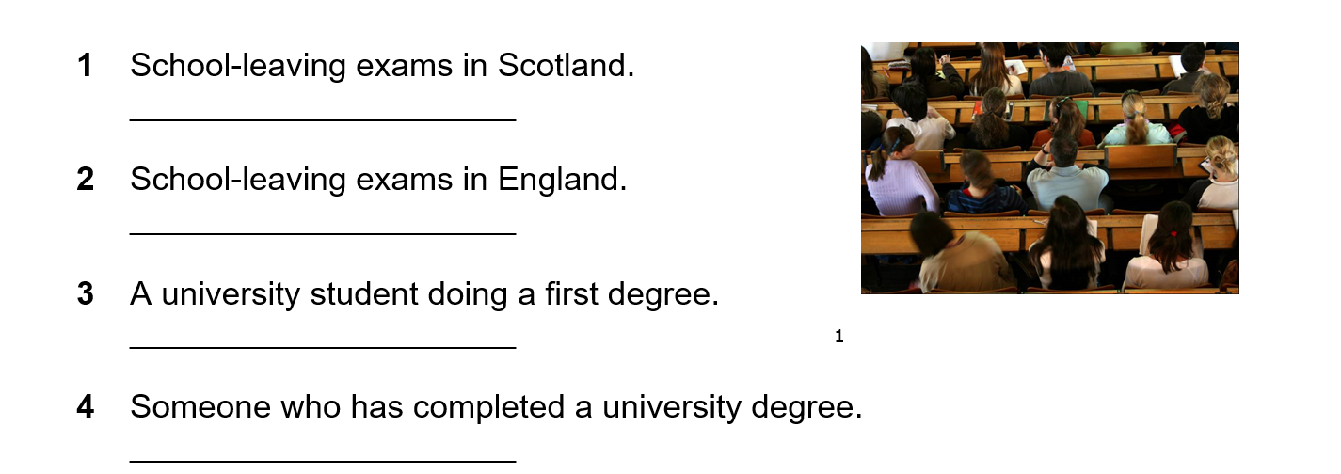
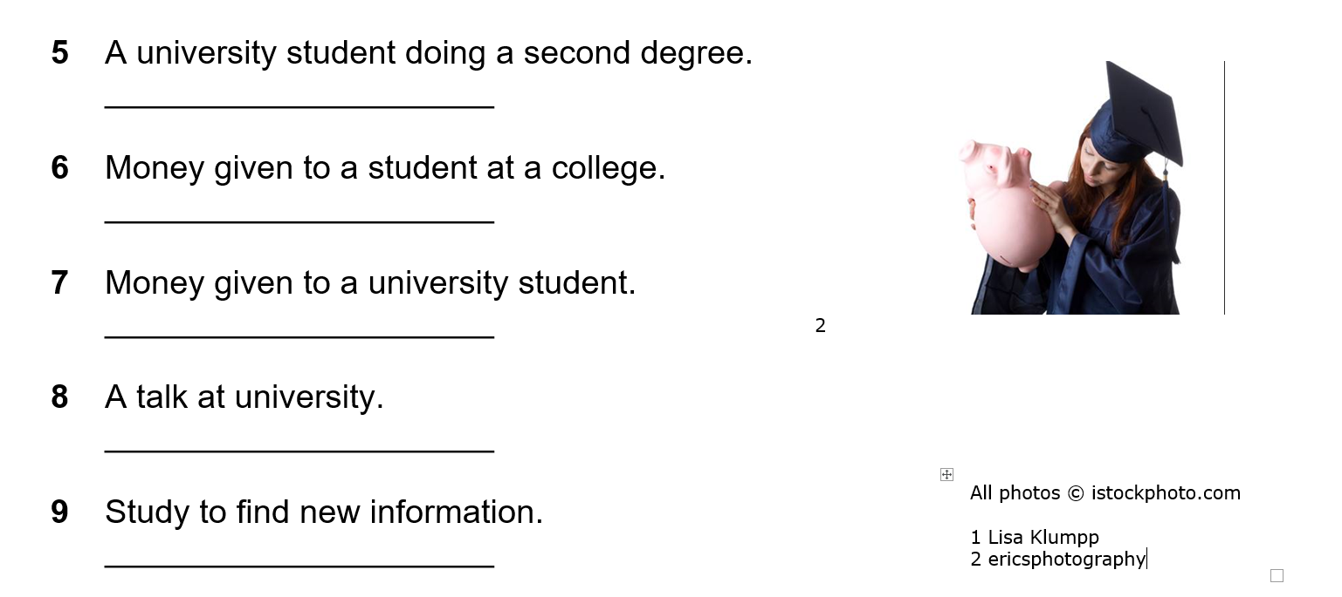
Activity 4 – Vocabulary
Highers
A levels
undergraduate
graduate

Slide 8
Activity 4 – Vocabulary
postgraduate
bursary
grant / loan
lecture
research

Slide 9
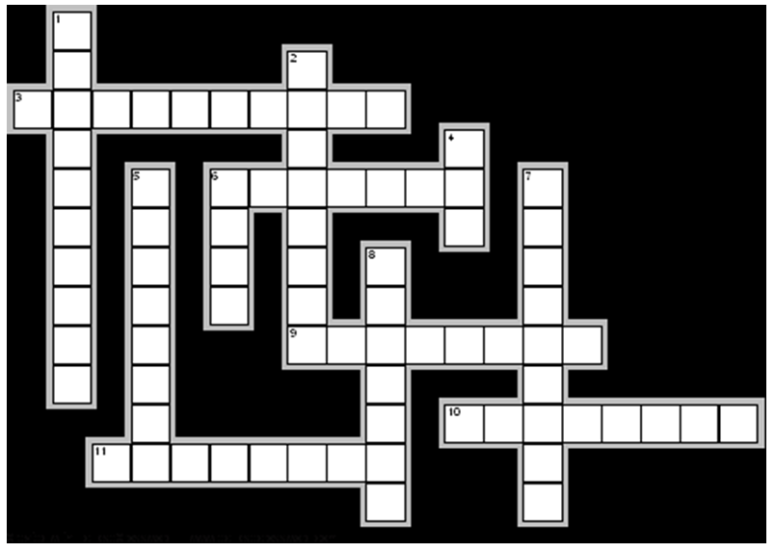












Activity 4 - Vocabulary

Slide 10
Activity 5 - Writing
Write about 40 words
Write your ideas about private schools
Do you agree with private schools?
Do you disagree with private schools?

Slide 11
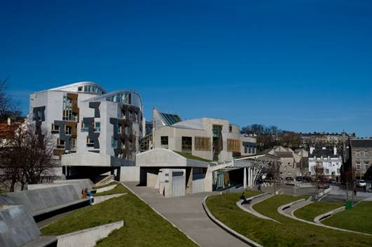
Homework Task
Imagine you are an important politician
Write about three changes you would make to education in Scotland
Give your reasons.
© istockphoto.com/warwick lister-kaye

Slide 12

The End!!

Slide 13
Thank you
Slides created by Aberdeenshire Council Community Learning and Development Team.
© Scottish Qualifications Authority 2007
Please note these materials have been repurposed for the new National Qualifications - August 2015
Image Credits © istockphoto/ or © Avril Morrison as indicated.
https://www.sqa.org.uk/sqa/33695.html

