Slide 1


Lesson 5
Work
Lesson
05
Work
Review of lessons 1-4
Review of lessons
1 - 4

Slide 2
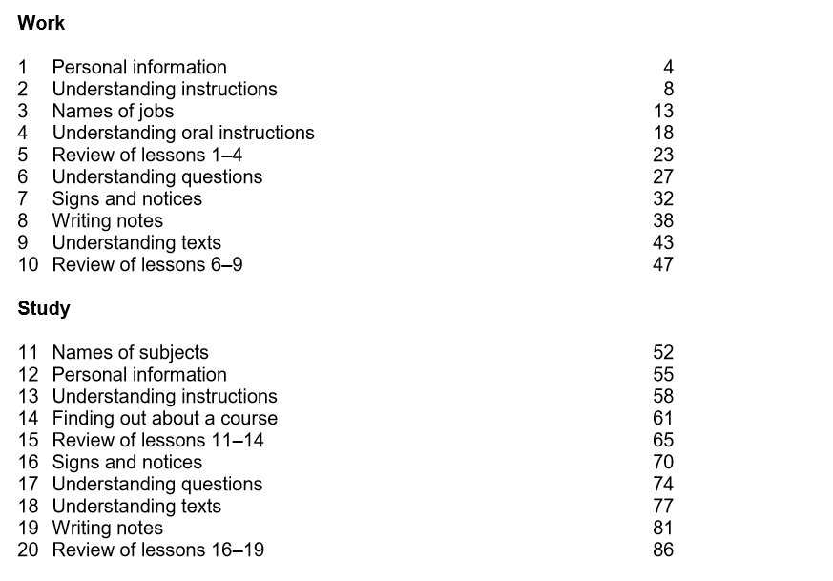

Slide 3
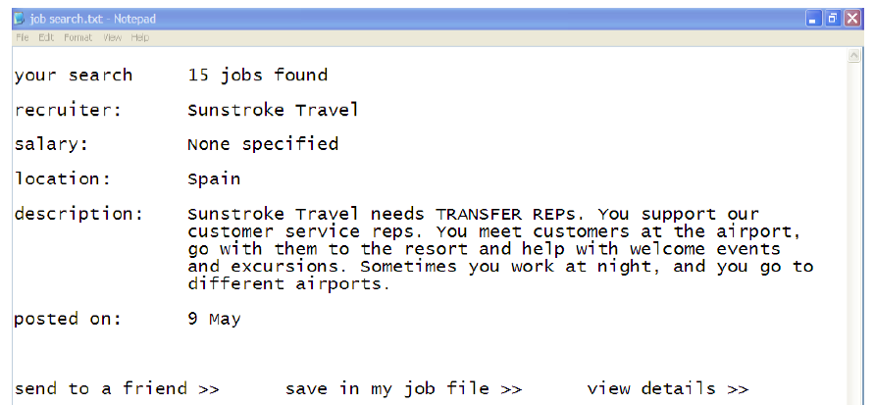
Activity 1 – Speaking

Slide 4
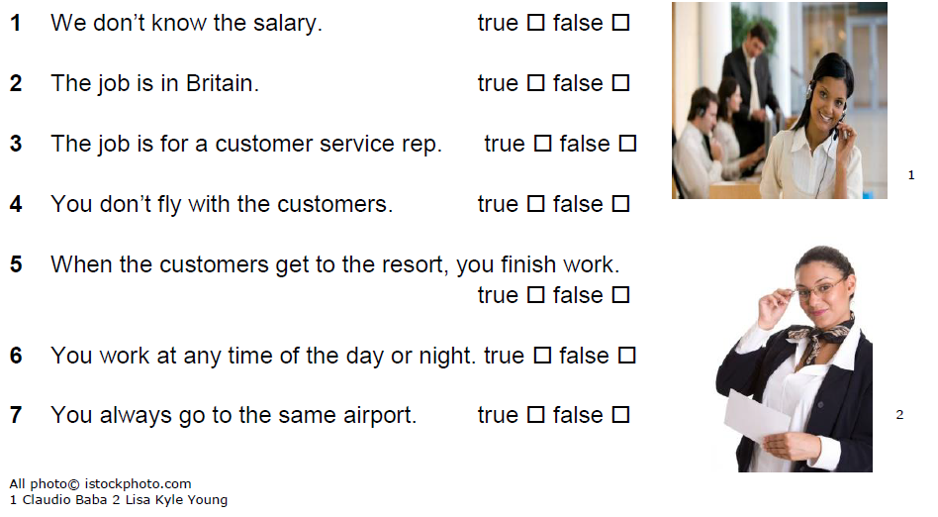

Activity 1 – Speaking

Slide 5

Activity 2 – Reading

Slide 6
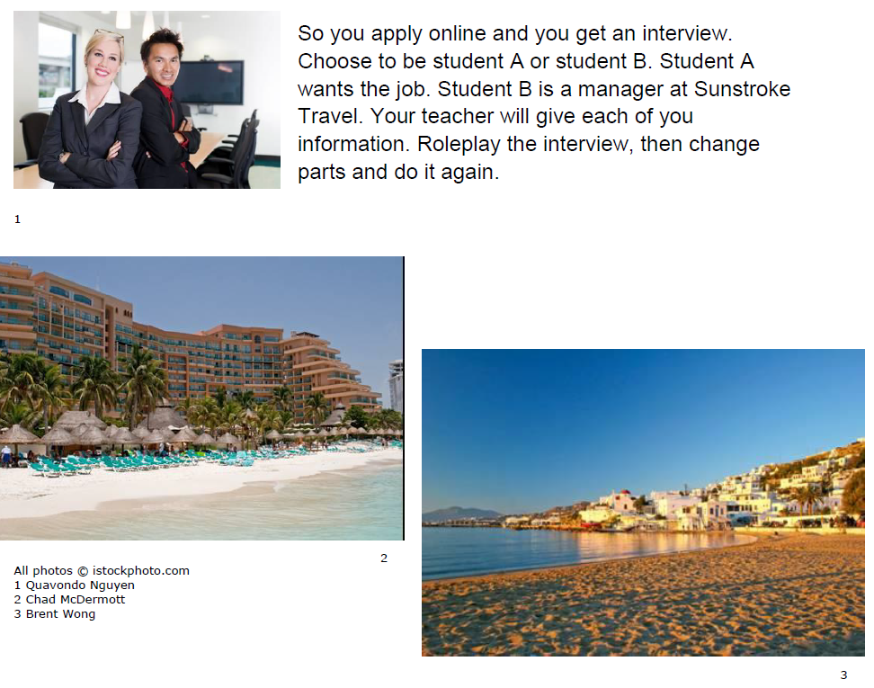
Activity 2 – Reading

Slide 7
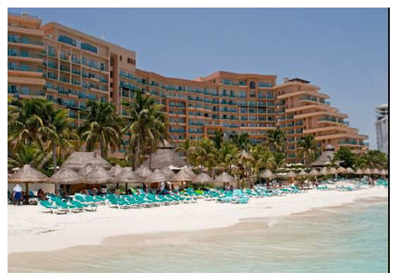
Activity 2 – Speaking
Role Play – Student A Information
At the interview you want to know more about the work
You also want to know:
How long the contract is
How much the pay is
Which town you work in
Where you live
If you get a car
How many hours you work
If you work overtime – if yes, how much the overtime pay is

Slide 8
Activity 2 – Speaking
Role Play – Student B Information
You have to explain the job to Student A. You also have
to give the information below.
Transfer Rep
Job details
Contract: 1 June – 30 September
Salary: £4,600
Location: Spain: Malaga or Benidorm
Accommodation: self-catering flat
Transport: non provided
Hours of work: 40, but sometimes overtime is necessary
Overtime rate: 1.5 times normal
Contract: June to September

Slide 9
Activity 3 – Language focus
Work with a partner. Write the correct form of each verb below. Where there are two verbs, join them with to.
 | Question | Negative
Elena want work in London | Does Elena want to work in London? | Elena does not want to work in London.
We work in a shop.
You have a car.
Veysel know you.
She loves you.
They want move to London.
You need make more money.
He try do a good job.
Elena like shop here.
Do we work in a shop?
We don’t work in a shop.
Do you have a car?
You don’t have a car.
Does Veysel know you?
Veysel doesn’t know you.
Does she love you?
She doesn’t love you.
Do they want to move to London?
They don’t want to move to London.
Do you need to make more
money?
You don’t need to make more
money.
Does he try to do a good job?
He doesn’t try to do a good job.
Does Elena like to shop here?
Elena doesn’t like to shop here

Slide 10
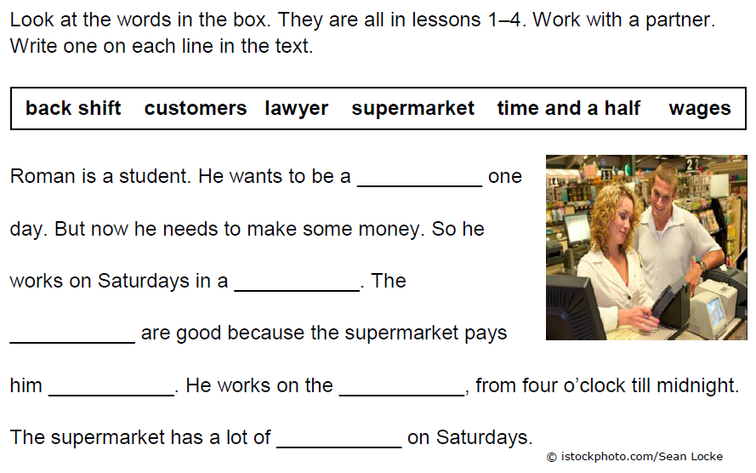
Activity 4 – Vocabulary
student
supermarket
wages
time and a half
back shift
customers

Slide 11
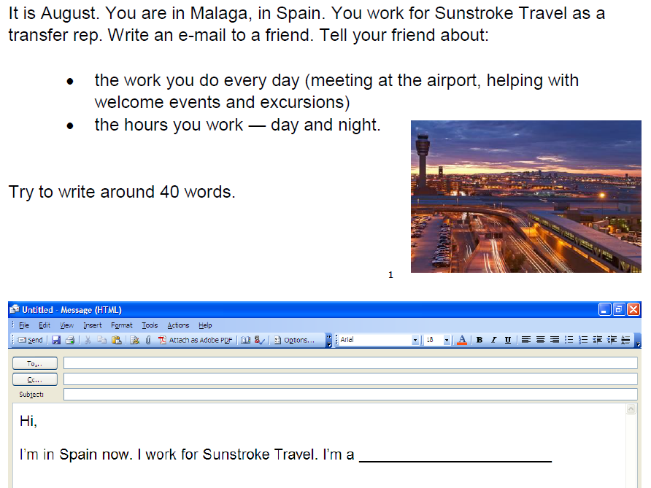
Activity 5 – Writing

Slide 12
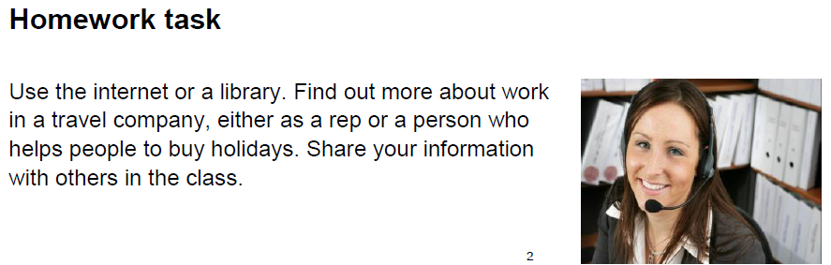
Unit 5 Homework task

Slide 13
Thank you
Slides created by Aberdeenshire Council Community Learning and Development Team.
© Scottish Qualifications Authority 2007
Please note these materials have been repurposed for the new National Qualifications - August 2015
Image Credits © istockphoto/ or © Avril Morrison as indicated.
https://www.sqa.org.uk/sqa/33695.html

