Slide 1


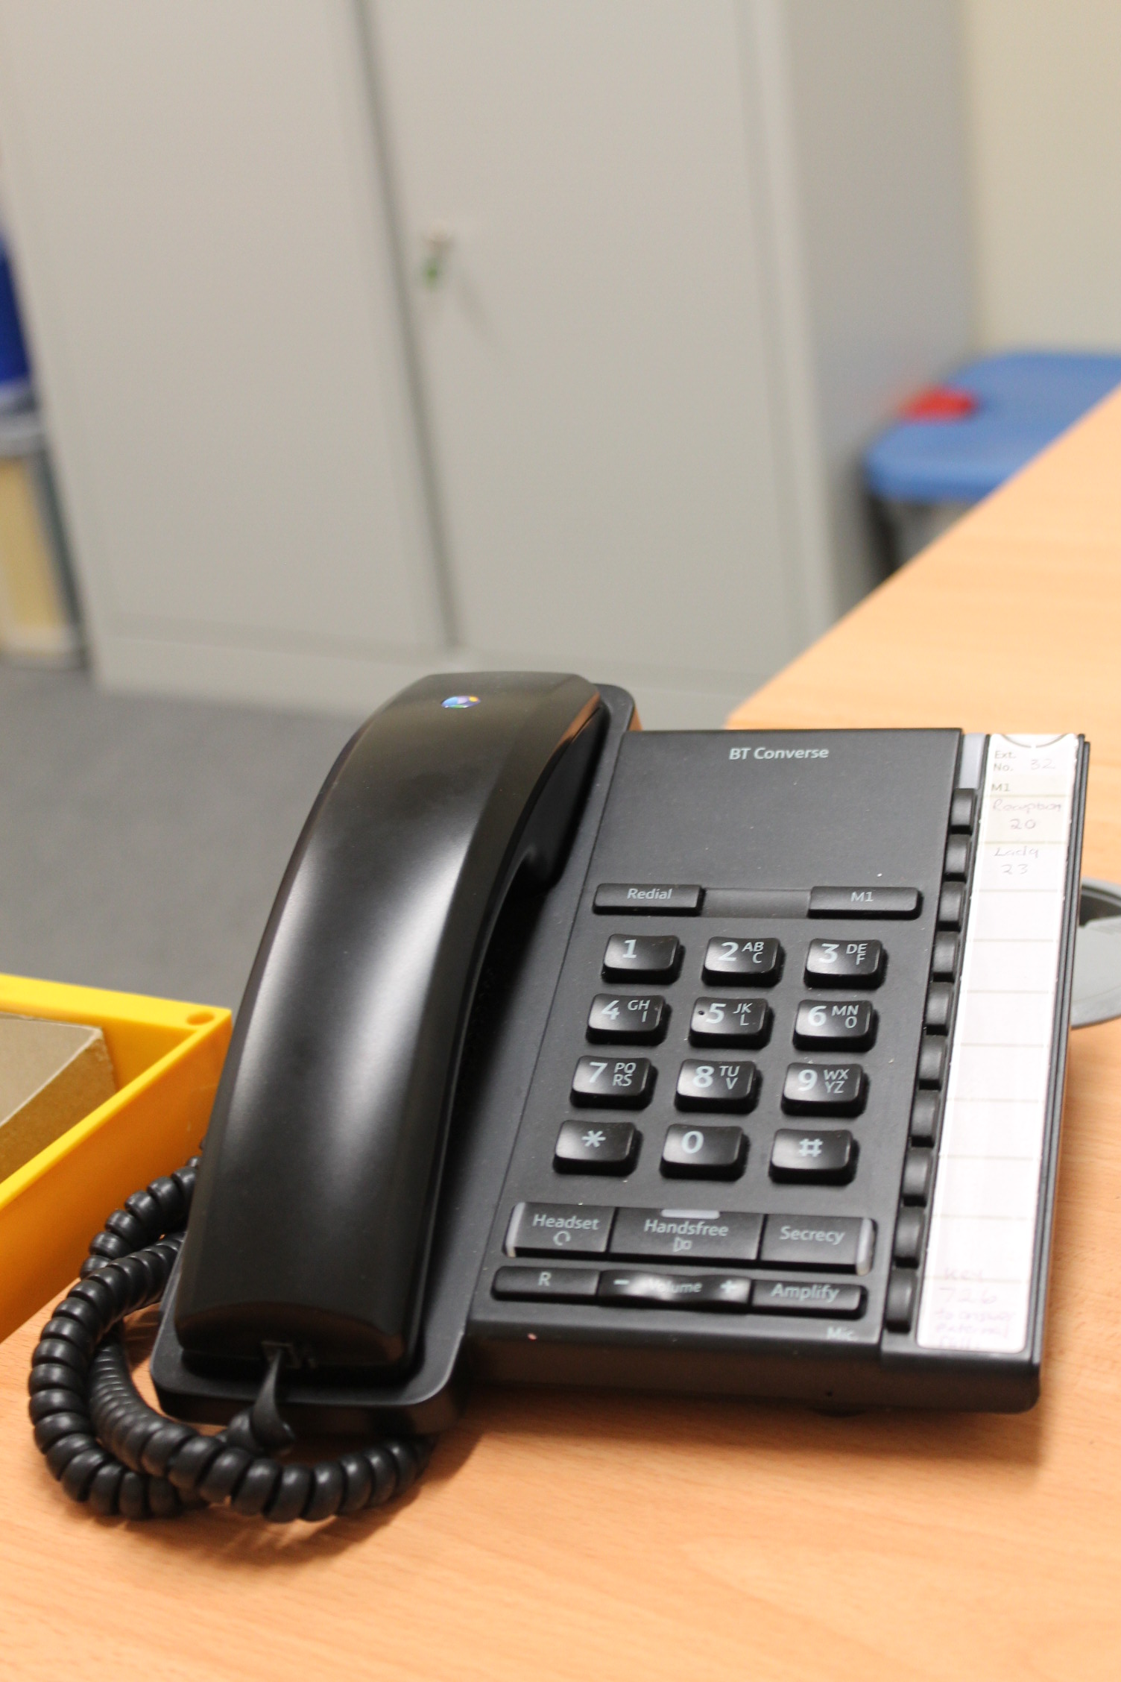
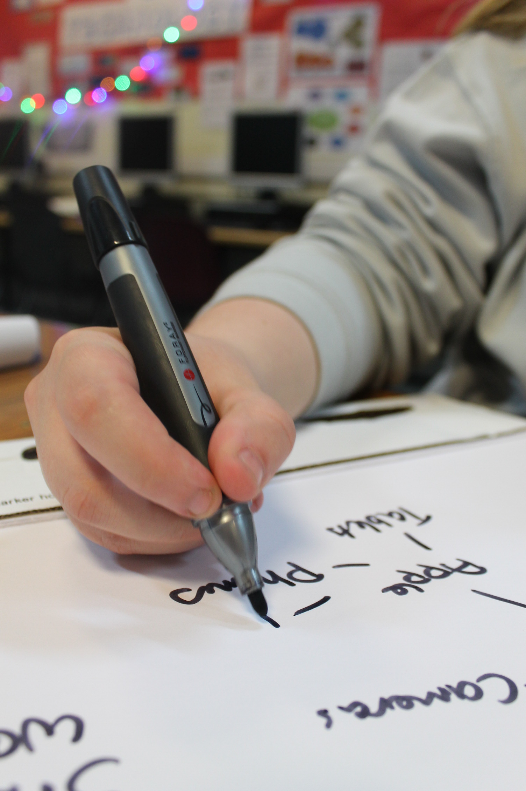
Unit 19
Writing Notes

Slide 2
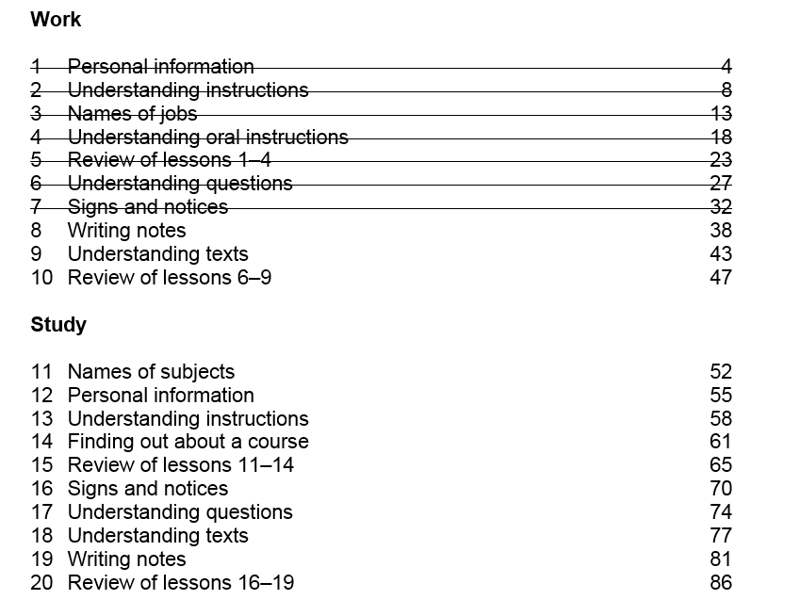

Slide 3
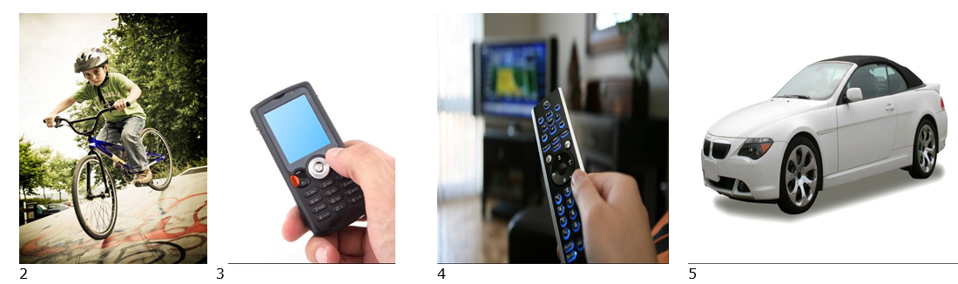
Homework Task
Think of five things you own
Clothing, a mobile phone, a TV, a bike, a book.
Write about them using three adjectives.
e.g. I have a nice warm woolly jumper
Write 40 words
All photos © istockphoto.com 1 Eric Hood 2 Alexander Hafemann 3 Fuat Kose 4 Terraxplorer 5 Konstantin Sukhinin

Slide 4
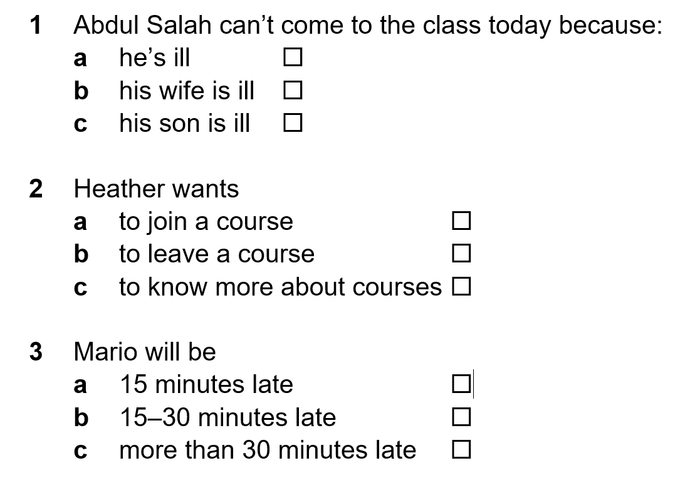

Activity 1 - Listening
✓
✓
✓

Slide 5
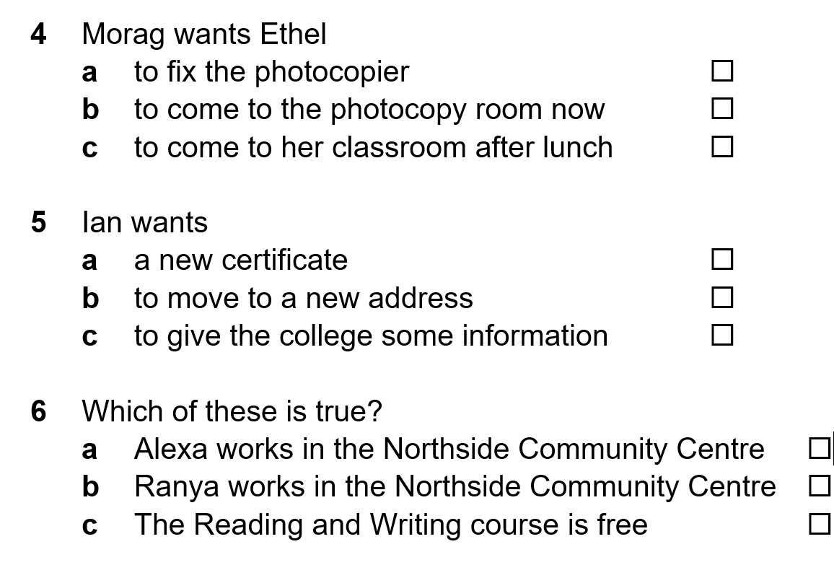
Activity 1 - Listening
✓
✓
✓

Slide 6
Activity 2 - Speaking
1 Phone your tutor. You can’t come to class today. Give a reason
and say that you’ll be there for the next class
2 Phone a college. Ask for information about computer courses
3 Phone an office. Give your name. You have an interview today. Say the time.
Say you will be 15-30 minutes late. Apologise.
4 Phone your office on an internal phone. Say where you are. The
photocopier isn’t working. Ask for help.
5 Phone your tutor. Say the sent your certificate to the wrong address.
Give your correct address.
6 Phone your local Community Centre. Ask about the cost of a yoga class.
Ask when the classes are.

Slide 7
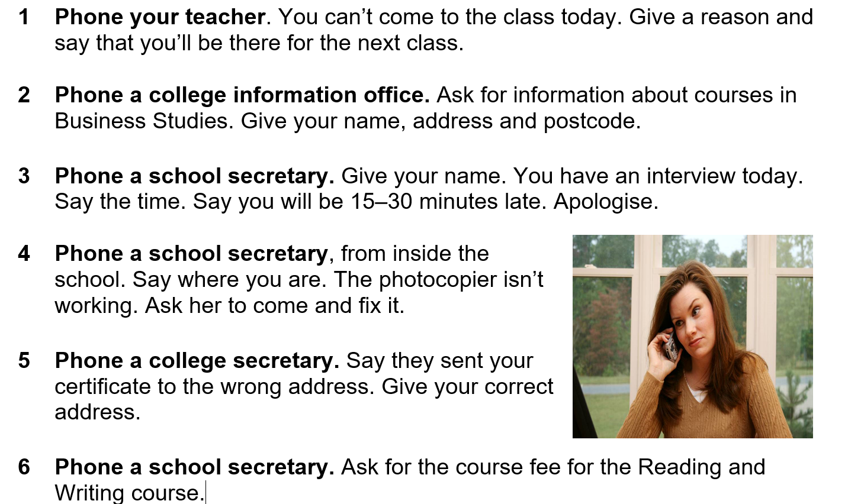
Activity 2 - Speaking

Slide 8
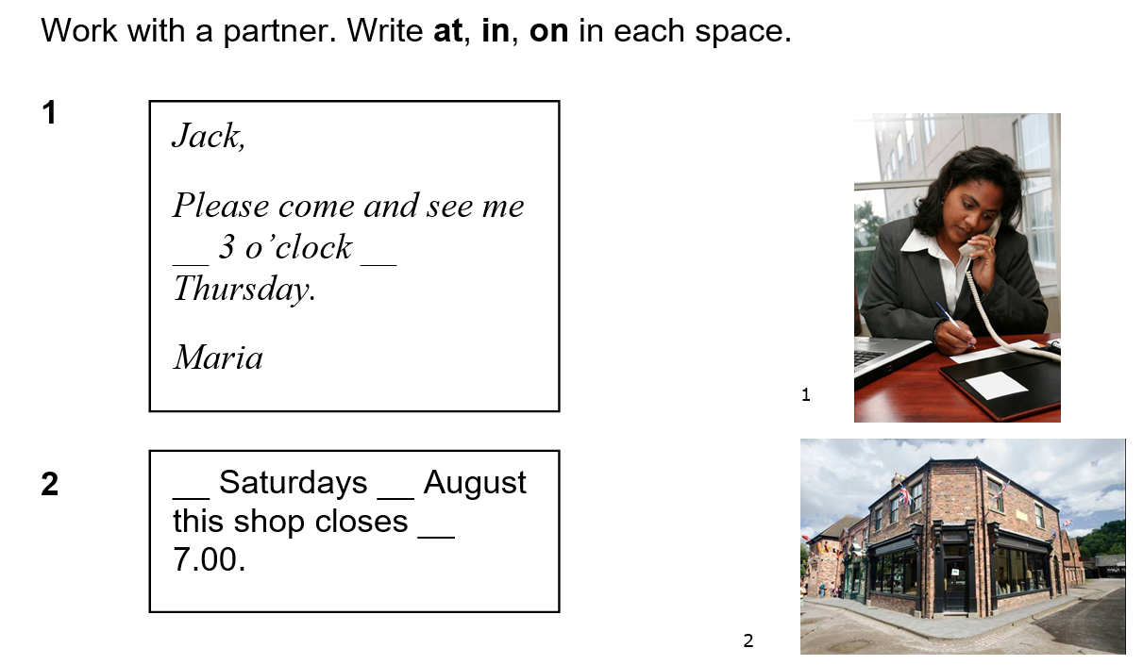

Activity 3 – Grammar
at
on
On
in
at

Slide 9

Activity 3 – Grammar
In
at
at
on

Slide 10
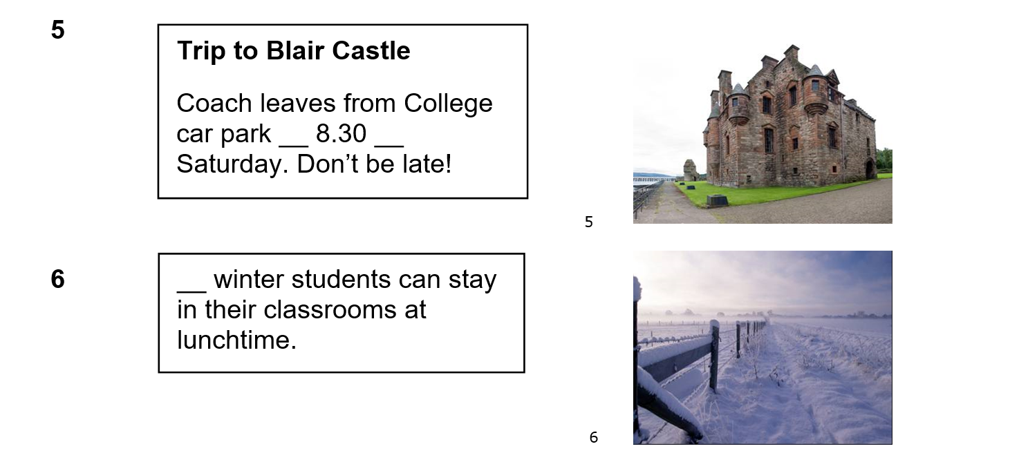
Activity 3 – Grammar
at
on
In

Slide 11
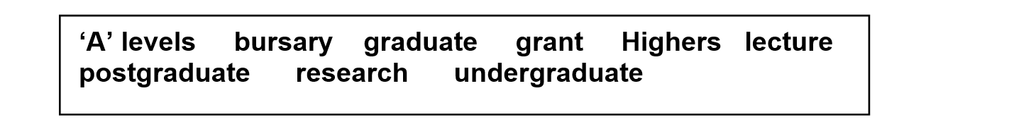
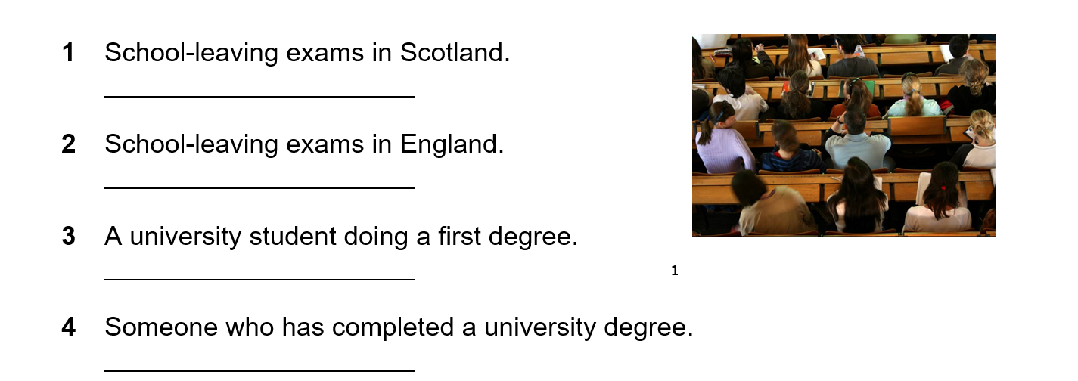
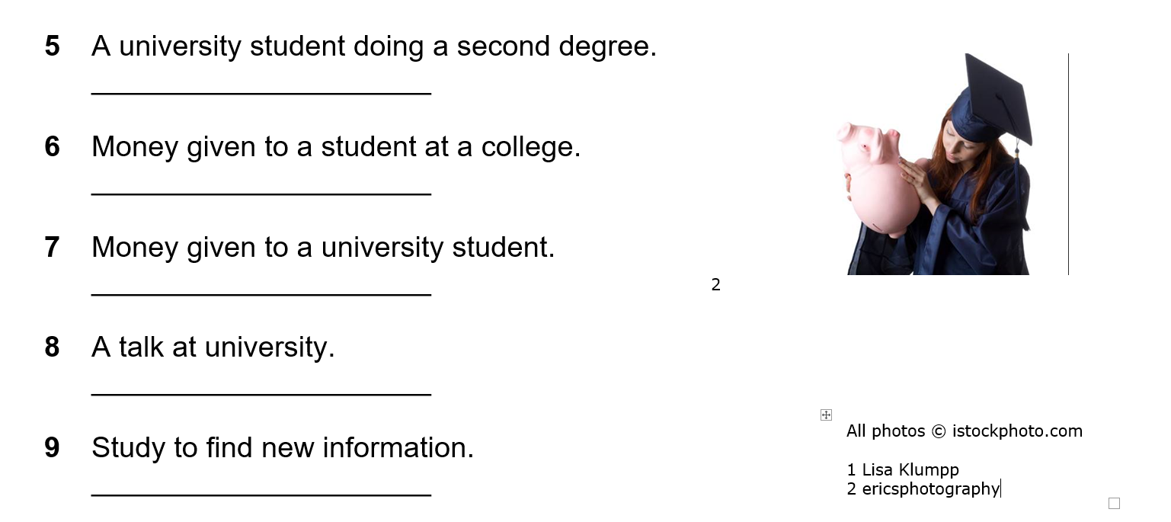
Activity 4 – Vocabulary
Highers
A levels
undergraduate
graduate

Slide 12
Activity 4 – Vocabulary
postgraduate
bursary
grant / loan
lecture
research

Slide 13
Activity 5 - Writing
You have to be away from your class for two weeks. Think of a reason.
It could be a holiday, illness or because someone in your family needs your help.
Write a note to your teacher.
Explain how long your will be away and when you will return.
Tell your teacher the reason why and give your apologies.

Slide 14
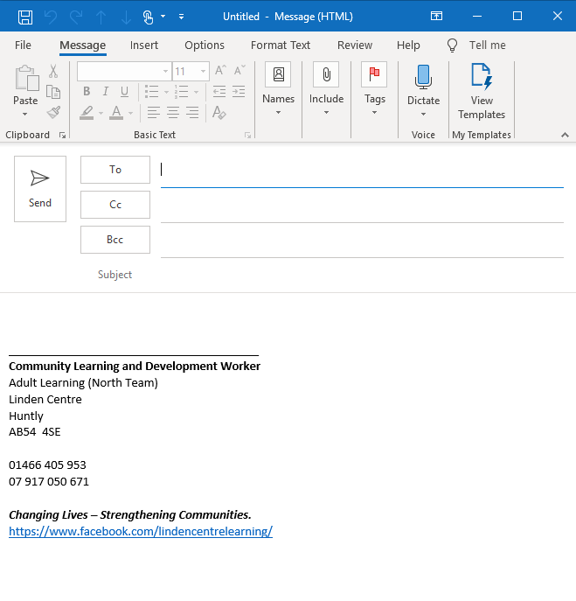
Homework Task
Write an email to your tutor. Say that you have a new address
Give your old address and your new one

Slide 15
Thank you
Slides created by Aberdeenshire Council Community Learning and Development Team.
© Scottish Qualifications Authority 2007
Please note these materials have been repurposed for the new National Qualifications - August 2015
Image Credits © istockphoto/ or © Avril Morrison as indicated.
https://www.sqa.org.uk/sqa/33695.html

