Slide 1


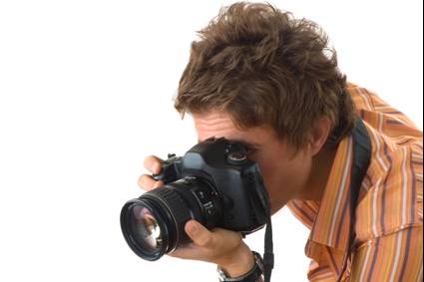
Lesson 18
Understanding
Texts
© istockphoto.com 1 Korhan Hasim Isik

Slide 2
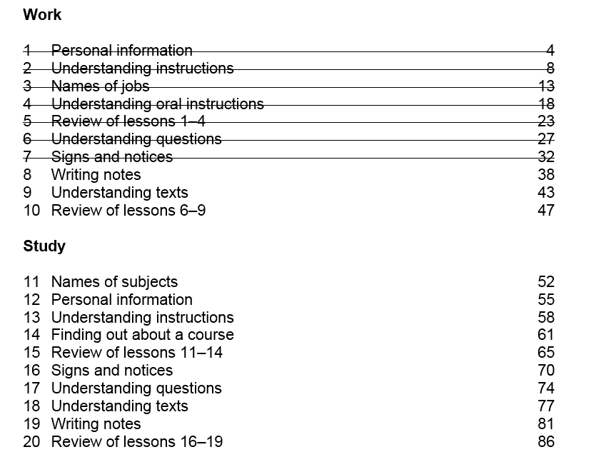

Slide 3
Activity 4 –Homework Task
Think about a person you admire (your family, a friend or on TV)
Would you like their job?
Could you do their job?
Do you want a job like this in the future?
Write 40 words

Slide 4
Activity 1 - Reading
Studying in Edinburgh
Hi — I’m Pavel Kaperi. I’m Italian. I first came to Scotland three years ago. I studied English at a college in Edinburgh. I enjoyed life in Scotland so I stayed.
I did another year of English. I’m very interested in photography and I decided that could be a good job. So now I’m doing a course in photography.

Slide 5
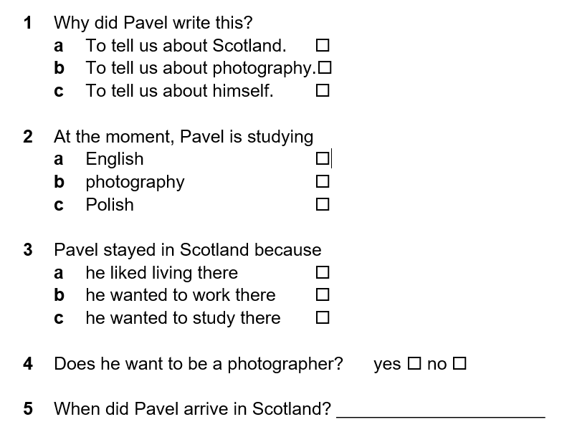
Activity 1 – Reading
✓
✓
✓
✓
three years ago

Slide 6
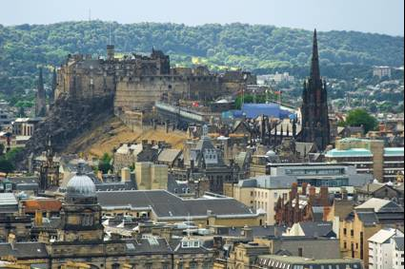
Activity 2 - Speaking
Work with a partner
Ask your partner about their life in Scotland
When did they come here?
Where did they come from?
Who did they come with?
When did they start English classes?
Is this their first class?
Have they been in another English class before this?
© istockphoto.com texasmary

Slide 7
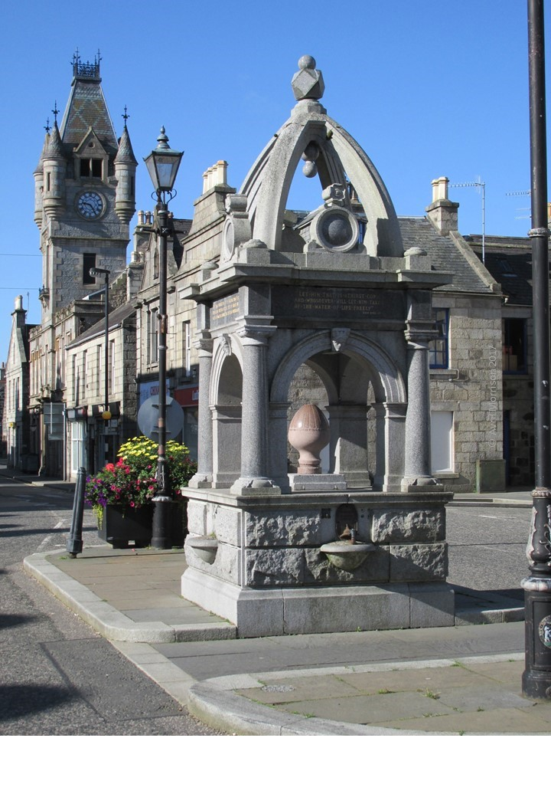
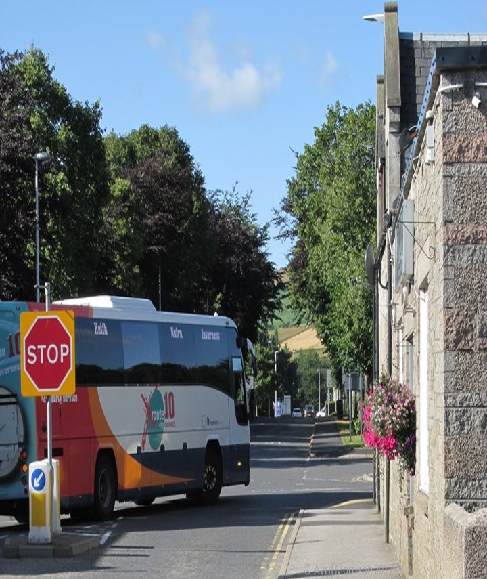
Activity 3 – Writing
Write about a classmates life in Scotland
Write about 40 words.

Slide 8
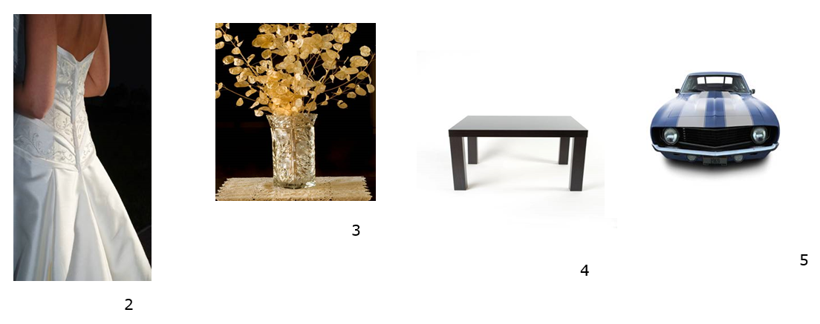
Activity 4 – Grammar
Size Big/ Small
Shape Round/Long
Age New/ Old
Colour Blue/ White
Nationality British/ Lithuanian
Material Crystal / Leather
All photos © istockphoto.com 2 Rebecca Arnold 3 David Scheuber 4 Arthur Kwiatkowski 5 Brian Sullivan

Slide 9
Activity 4 – Grammar
Add the adjective to the correct space
A big, blue,
American car.
All photos © istockphoto.com 2 Rebecca Arnold 3 David Scheuber 4 Arthur Kwiatkowski 5 Brian Sullivan

Slide 10
Activity 4 – Grammar
Add the adjective to the correct space
1 A big, blue, American car.
2 A brown, china coffee pot
3 A long, white evening dress.
4 A nice, little Italian table.
5 A nice crystal flower vase.
6 An exciting, British gangster film.
All photos © istockphoto.com 2 Rebecca Arnold 3 David Scheuber 4 Arthur Kwiatkowski 5 Brian Sullivan

Slide 11
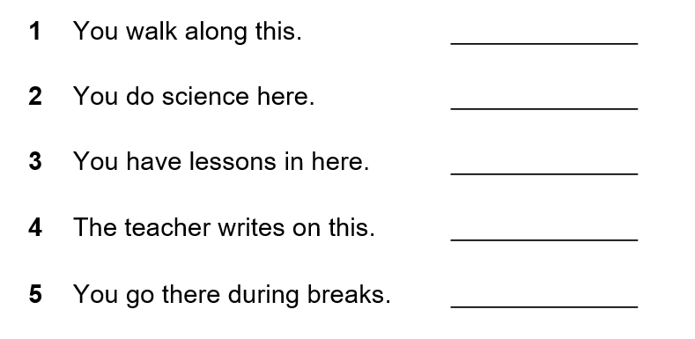
Activity 5 - Vocabulary
corridor
laboratory
classroom
board
playground (or staff room!)

Slide 12

Activity 5 - Vocabulary
notice board
register
bell
gym

Slide 13
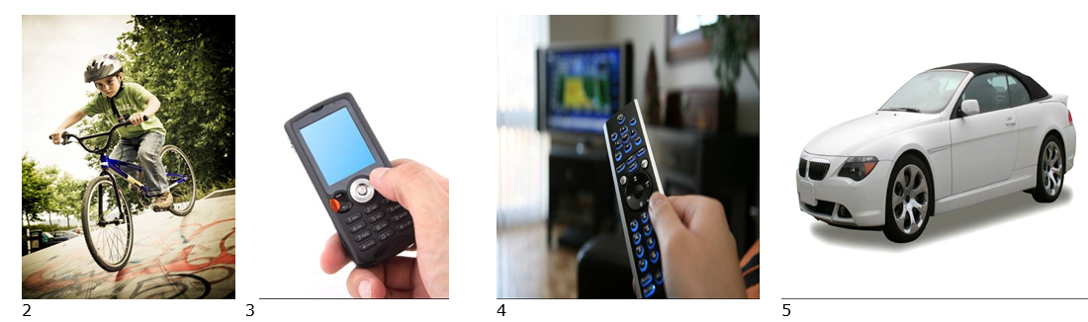
Homework Task
Think of five things you own
Clothing, a mobile phone, a TV, a bike, a book.
Write about them using three adjectives.
e.g. I have a nice warm woolly jumper
Write 40 words
All photos © istockphoto.com 1 Eric Hood 2 Alexander Hafemann 3 Fuat Kose 4 Terraxplorer 5 Konstantin Sukhinin

Slide 14
Thank you
Slides created by Aberdeenshire Council Community Learning and Development Team.
© Scottish Qualifications Authority 2007
Please note these materials have been repurposed for the new National Qualifications - August 2015
Image Credits © istockphoto/ or © Avril Morrison as indicated.
https://www.sqa.org.uk/sqa/33695.html

