Slide 1


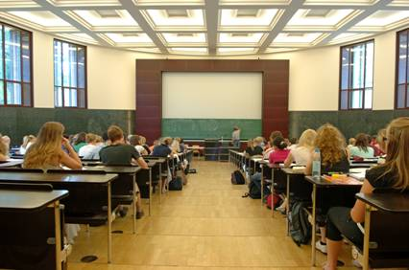
Lesson 17
Understanding
Questions
Image Credit© istockphoto.com/Dr Heinz Linke

Slide 2
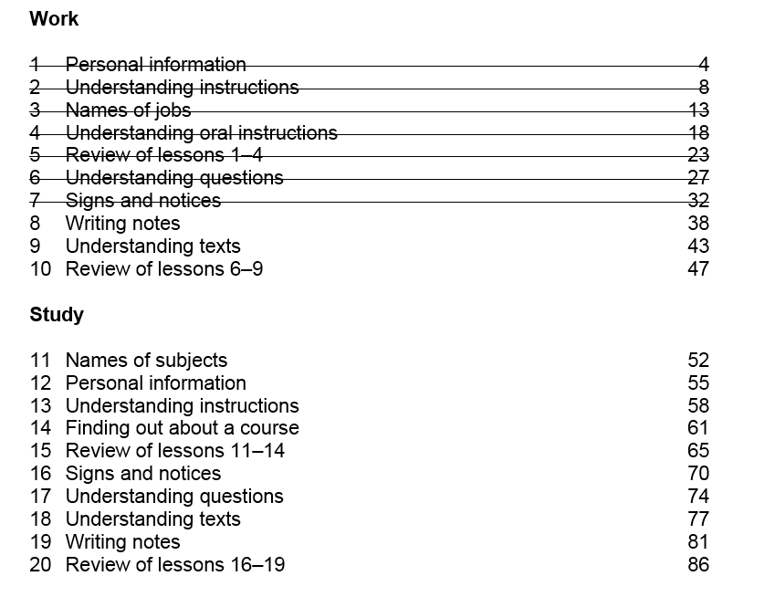

Slide 3

Homework Task
English for Academic Purposes
English as a Second Language
English for Speakers of Other Languages
English for Specific Purposes (e.g. Healthcare)
Further Education (e.g. college)
Higher Education (e.g. university)
Her Majesty’s Inspector
Higher National Certificate (college)
Higher National Diploma (college)
Scottish Certificate of Education
Scottish Qualifications Authority

Slide 4
Activity 1 -Speaking
Work with a partner.
Think of your self five years from now.
Will you be at college, university or at work?
What kind of job will you have?
Discuss this with your partner
Ask your partner questions about what they want to do.

Slide 5

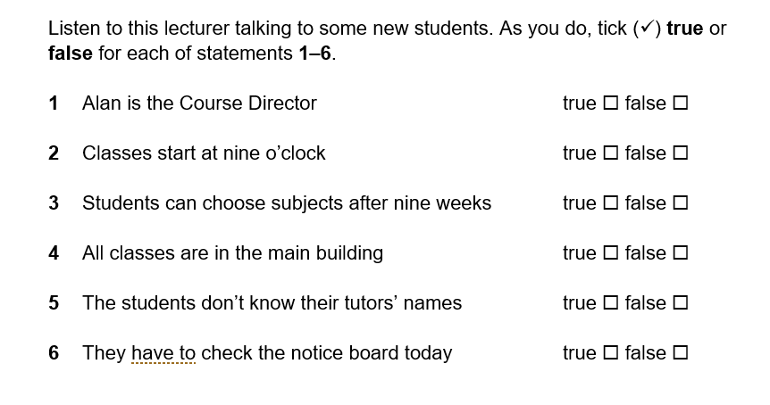
Activity 2 – Listening
Listen to the lecturer talking to some new students. “Good morning, my name is …”
✓
✓
✓
✓
✓
✓

Slide 6
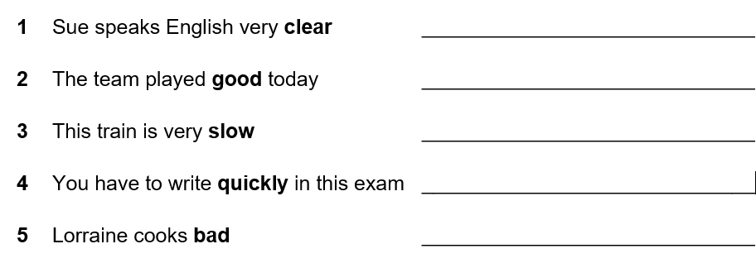
Activity 3 – Grammar - Adjectives and Adverbs
clearly
well
✓
✓
badly

Slide 7
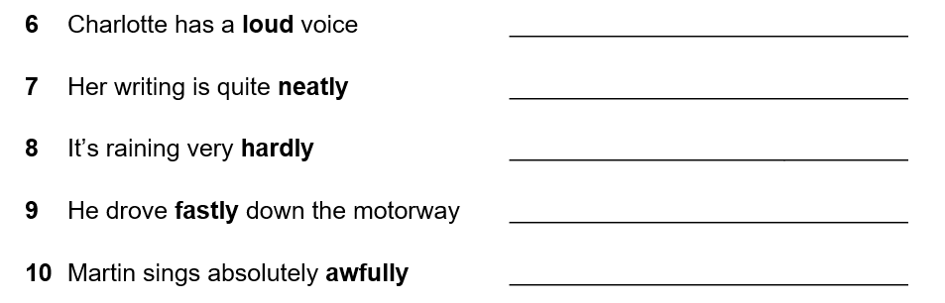
Activity 3 – Grammar - Adjectives and Adverbs
✓
neat
hard
fast
✓

Slide 8

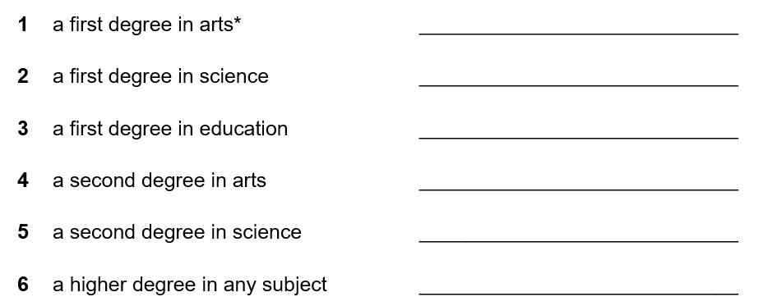
Activity 4 – Vocabulary
© istockphoto.com/RichVintage
BA
BSc
Undergraduate
BEd
MA
MSc
Postgraduate
PhD

Slide 9

Activity 5 - Writing
Write about your plans for the next 5 years
What would you like to learn?
Where would you like to be?
What work would you like to do?
Image Credit – istockphoto.com Renne Lee

Slide 10
Activity 4 –Homework Task
Think about a person you admire (your family, a friend or on TV)
Would you like their job?
Could you do their job?
Do you want a job like this in the future?
Write 40 words

Slide 11
Thank you
Slides created by Aberdeenshire Council Community Learning and Development Team.
© Scottish Qualifications Authority 2007
Please note these materials have been repurposed for the new National Qualifications - August 2015
Image Credits © istockphoto/ or © Avril Morrison as indicated.
https://www.sqa.org.uk/sqa/33695.html

