Slide 1



Lesson 16
Signs and Notices
Image Credit © istockphoto.com 1 Jacob Wackerhausen

Slide 2
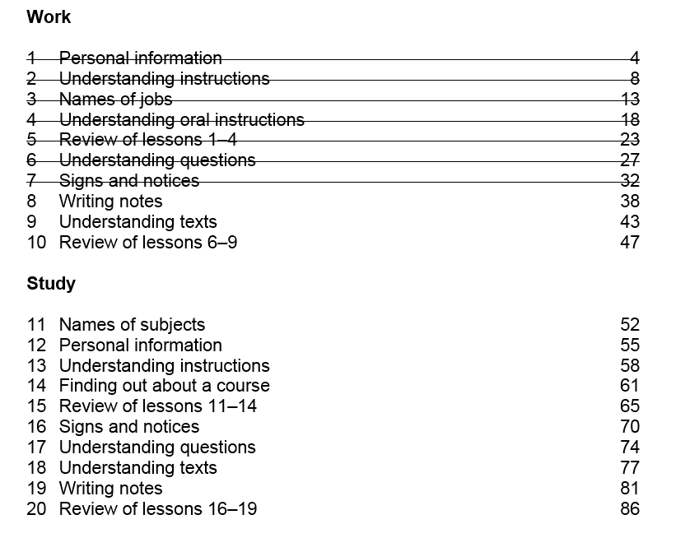

Slide 3

Homework Task

Slide 4
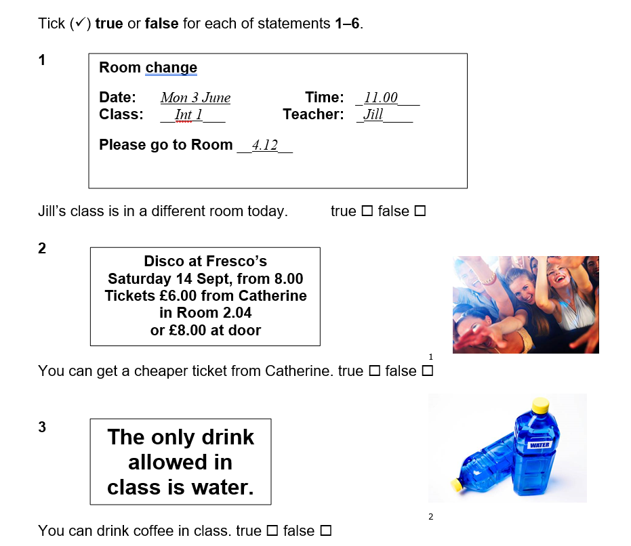
Activity 1 - Reading
✓
✓
✓

Slide 5
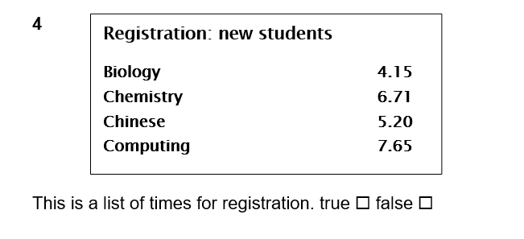
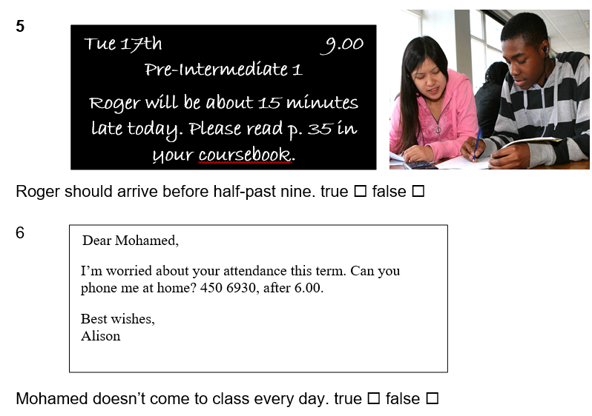
Activity 1 - Reading
✓
✓
✓

Slide 6
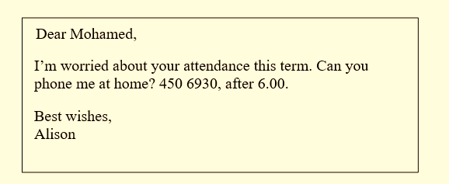
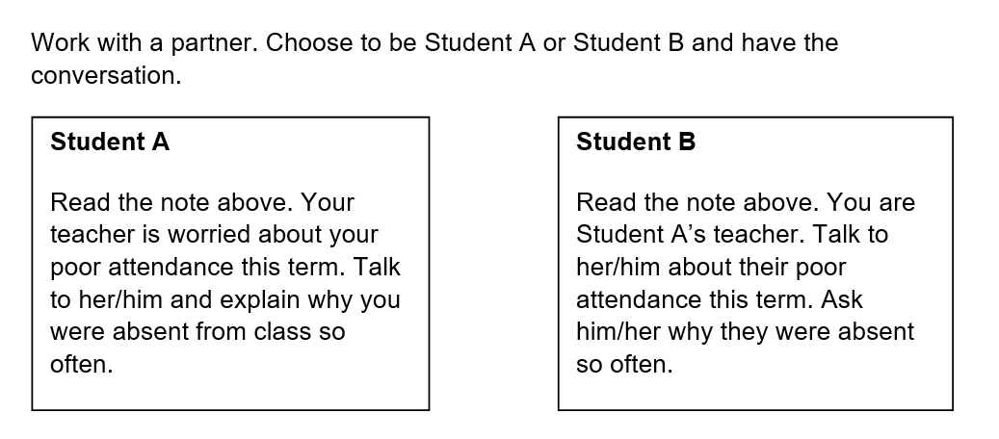
Activity 2 -Speaking

Slide 7
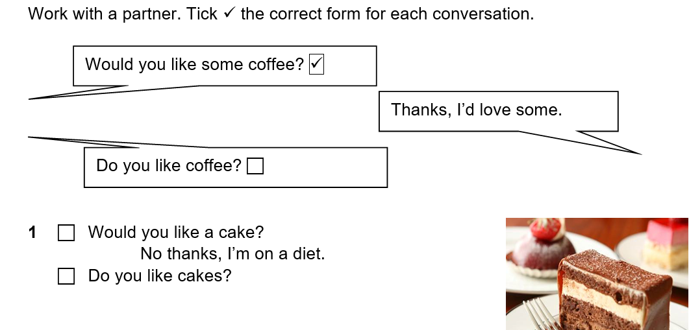
Activity 3 – Grammar - Would you… / Do you….
✓

Slide 8
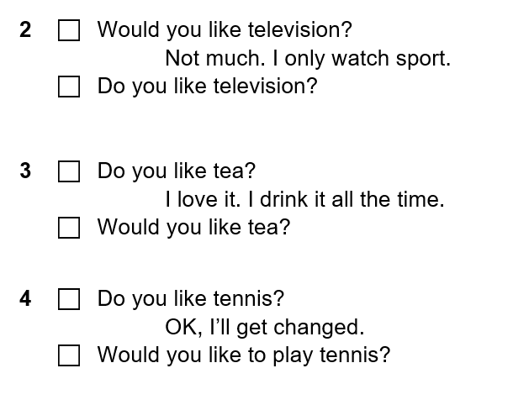
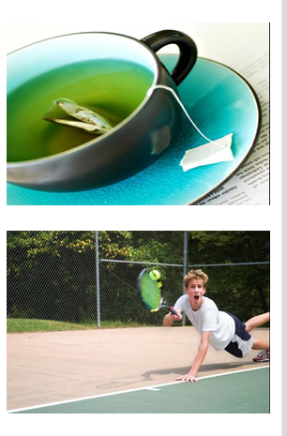
Activity 3 – Grammar
✓
1
✓
2
Image credit: istockphoto.com 1 Satu Knape 2 Forest Woodward
✓

Slide 9
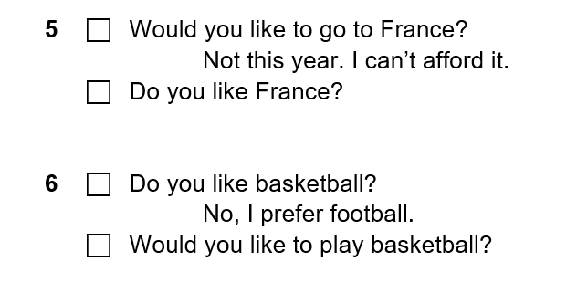
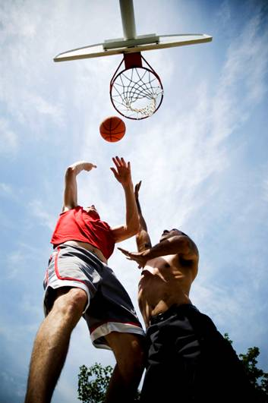
Activity 3 – Grammar
✓
✓
Image Credit – istockphoto.com Renne Lee

Slide 10
Activity 4 - Vocabulary
headteacher, lecturer, professor, teacher, tutor
School | University
headteacher
professor
teacher
lecturer
tutor

Slide 11
Activity 4 - Vocabulary
tutor, senior community worker, session leader,
community worker
Community Learning and Development
Senior Community worker (SQA Internal Verifier )
Community Worker (SQA Assessor)
Session leader
Tutor

Slide 12
Activity 5 -Writing
headteacher, lecturer, professor, teacher, tutor
Choose one of the jobs above.
Talk to your teacher about what this person does. Some of the other members of the class may have some ideas here.
Write about this job.
Try to write around 40 words.

Slide 13

Homework Task

Slide 14
Thank you
Slides created by Aberdeenshire Council Community Learning and Development Team.
© Scottish Qualifications Authority 2007
Please note these materials have been repurposed for the new National Qualifications - August 2015
Image Credits © istockphoto/ or © Avril Morrison as indicated.
https://www.sqa.org.uk/sqa/33695.html

