Slide 1

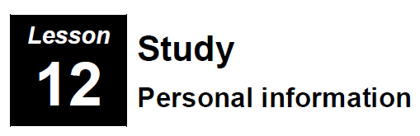
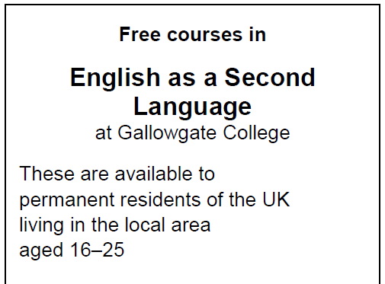
Unit 12
Study
Personal Information

Slide 2
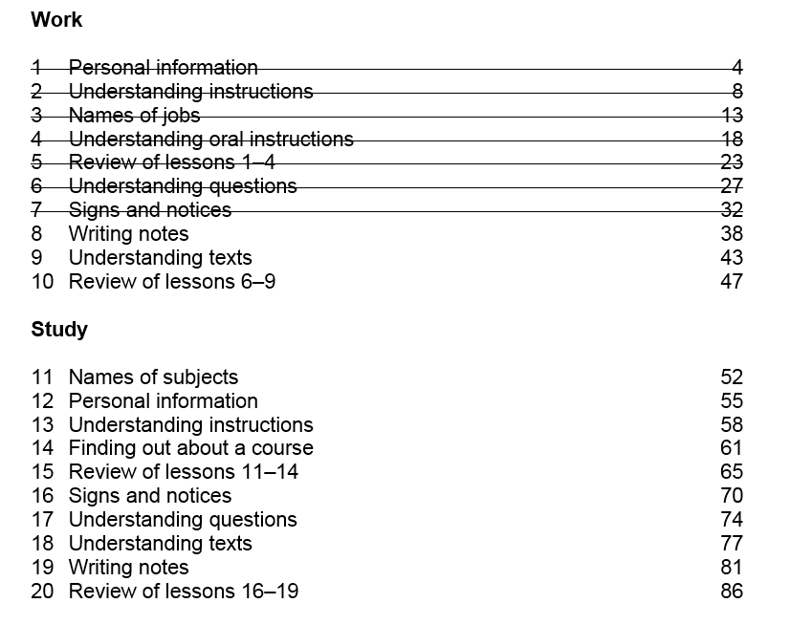

Slide 3
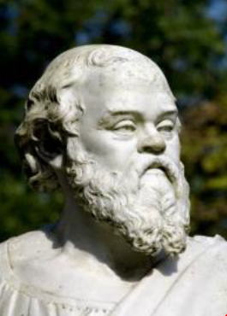
Unit 11 -Homework Task – Writing (50 words)
School subjects not studied in Scotland
© istockphoto.com Hans Laubel

Slide 4
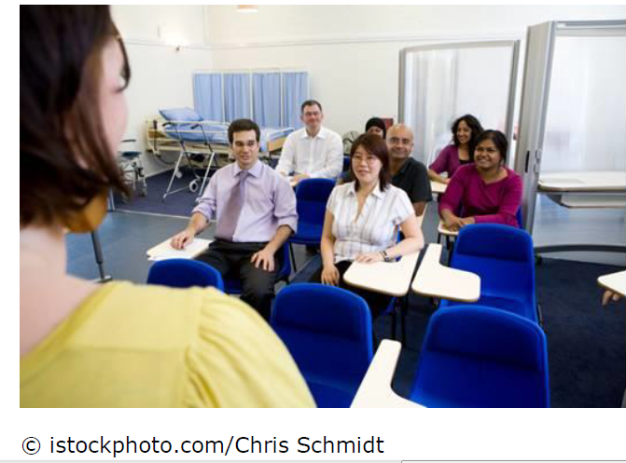
Unit 11 - Study

Slide 5
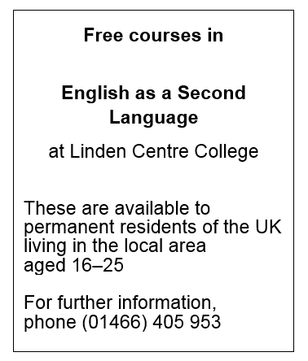
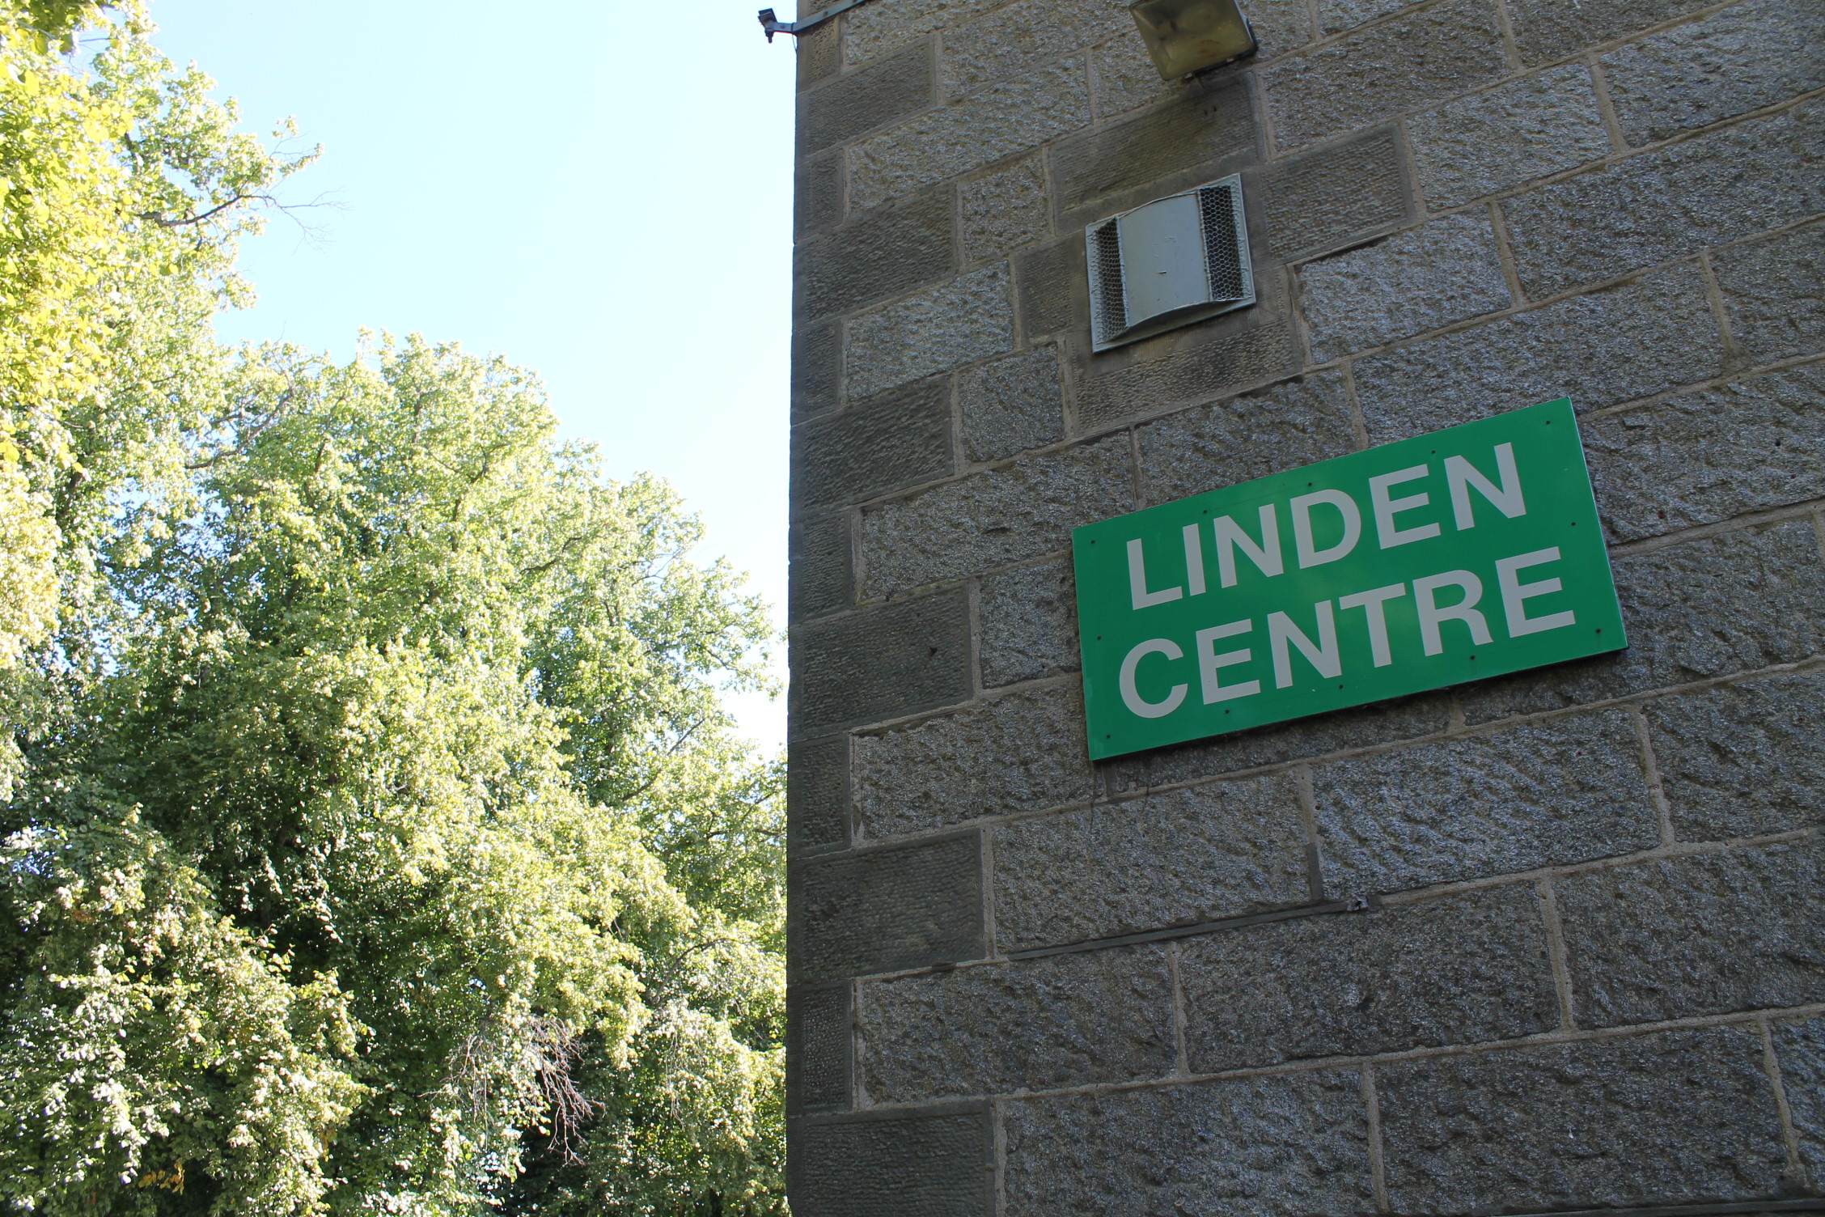
Unit 1 - Speaking
Work with a partner. Read this advert:

Slide 6
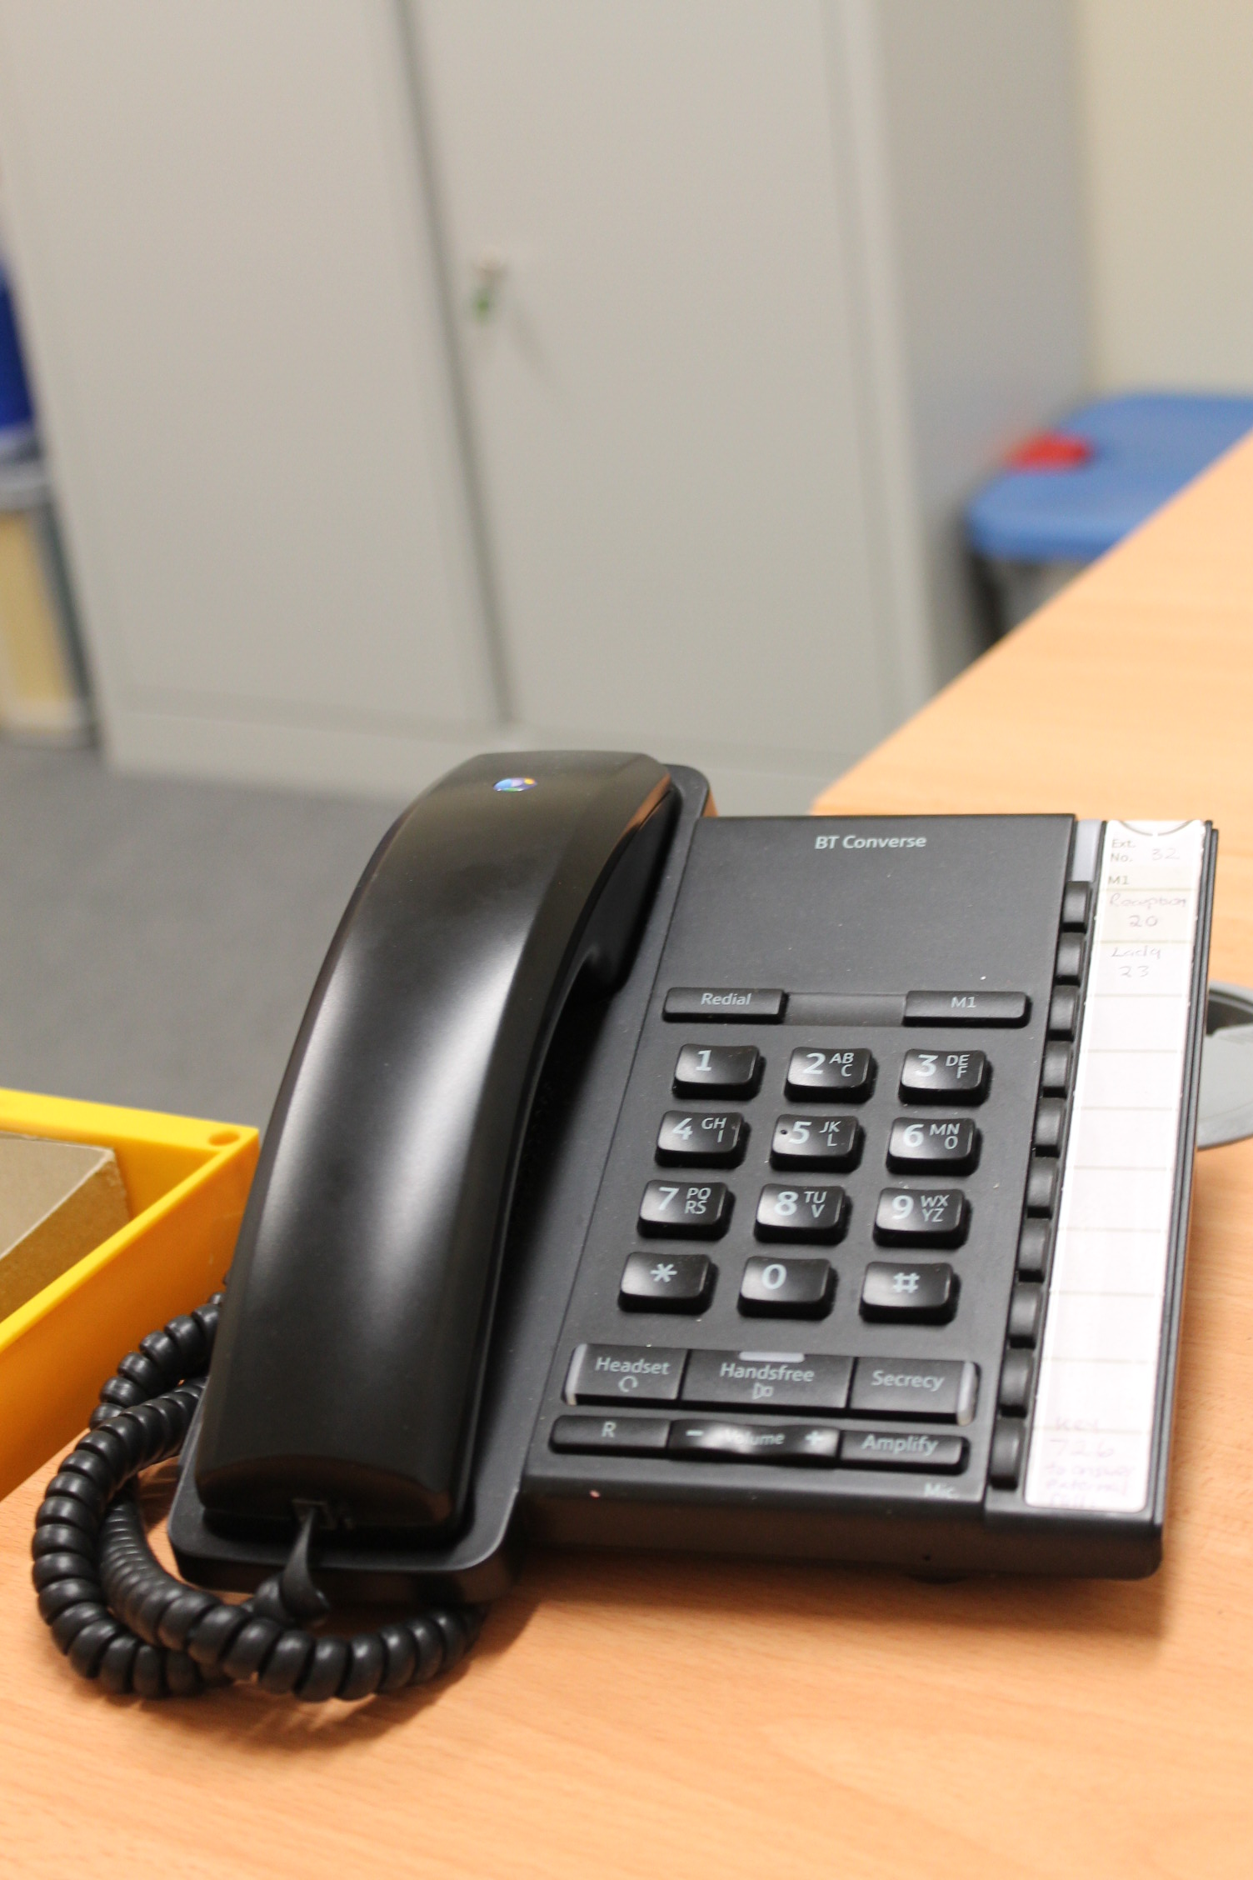
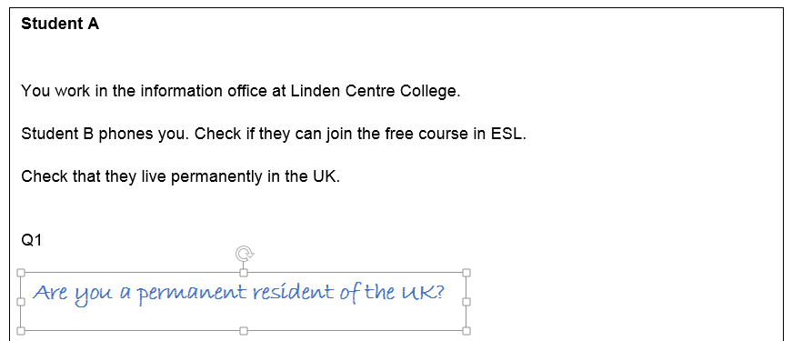
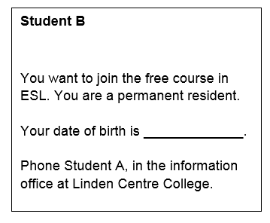
Activity 1 – Speaking
Read the role cards for Student A or Student B.
Student A – Write 3 questions to ask Student B
Student B – Choose a date of birth (!). Phone Student A and ask about the course.

Slide 7


⓪
①

↓




£100
Image Credit: Unicorn – The Noun Project – Studio GLD. Others Webdings

Slide 8
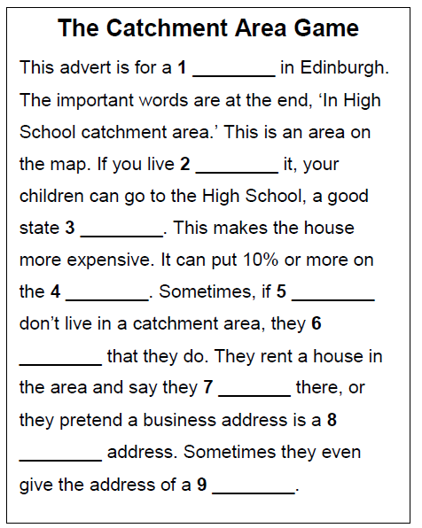
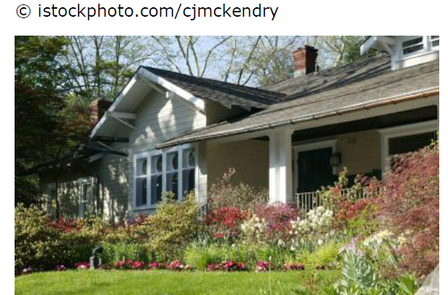
Activity 2 – Reading
house
inside
school
price
parents
pretend
live
private
relative

Slide 9
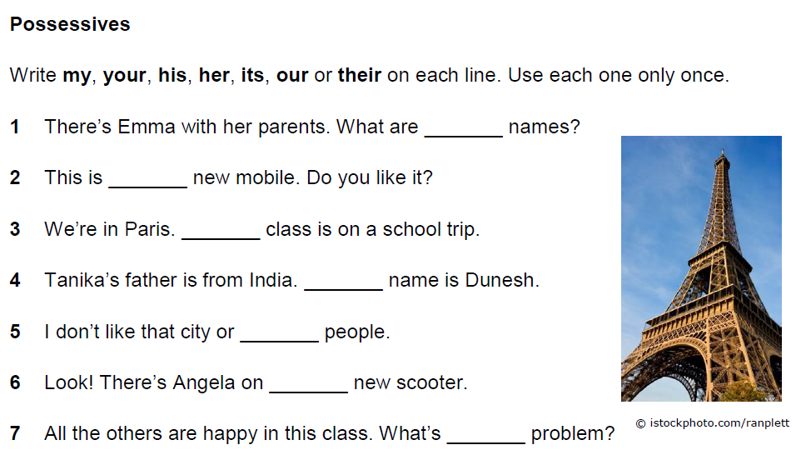
Activity 3 – Grammar
their
my
our
his
its
her
your

Slide 10
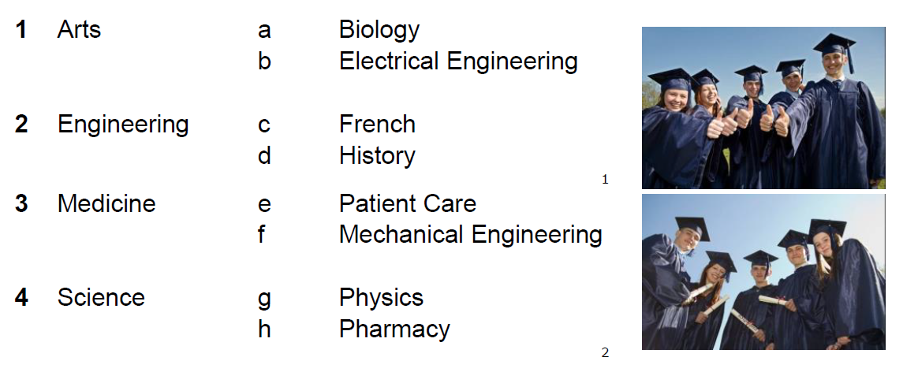

Activity 4 – Vocabulary

Slide 11
Activity 4 – Vocabulary
c French
d History
b Electrical Engineering
f Mechanical Engineering
e Patient Care
h Pharmacy
a Biology
g Physics

Slide 12
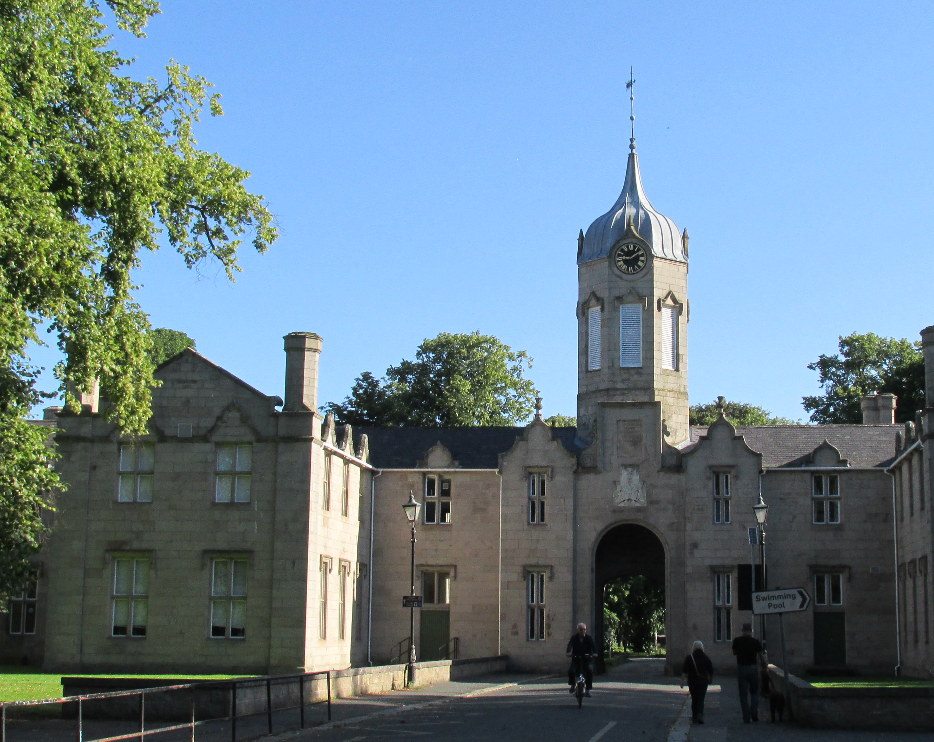
Activity 5 - Writing
Write about your old school
Describe the building
It was old / It was new…
Did you like school
I liked…. / I hated…
Why did you like / hate school?
How is your old school different from school in Scotland?
Is it better? Is it worse?

Slide 13
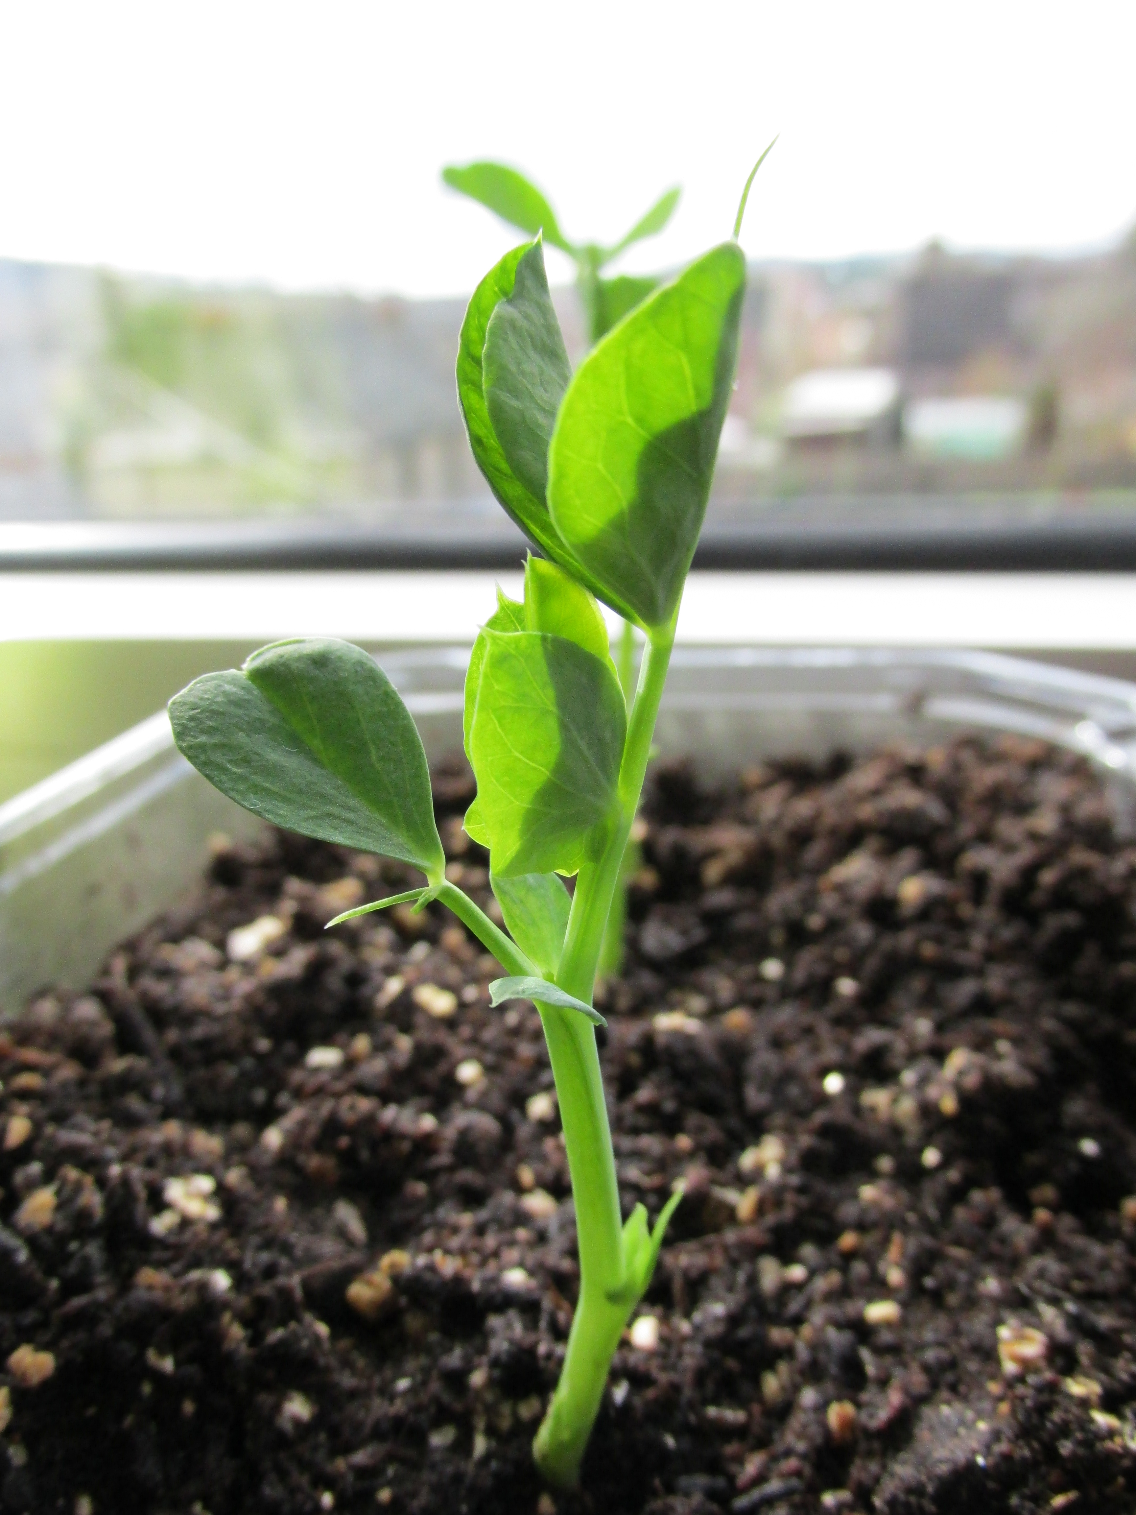
Unit 12 – Homework Task – Writing (50 words)
Pick a subject from the list. What do students study?
a French
b History
c Electrical Engineering
d Mechanical Engineering
e Patient Care
f Pharmacy
g Biology
h Physics

Slide 14
Thank you
Slides created by Aberdeenshire Council Community Learning and Development Team.
© Scottish Qualifications Authority 2007
Please note these materials have been repurposed for the new National Qualifications - August 2015
Image Credits © istockphoto/ or © Avril Morrison as indicated.
https://www.sqa.org.uk/sqa/33695.html

