Slide 1

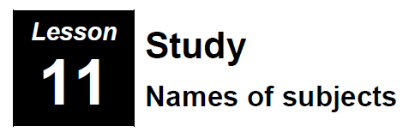
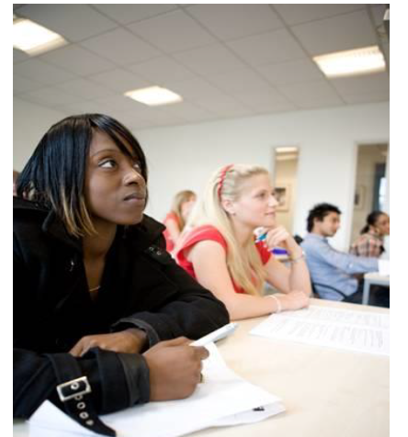
Lesson 11
Study
Names of Subjects
© istockphoto.com Chris Schmidt

Slide 2
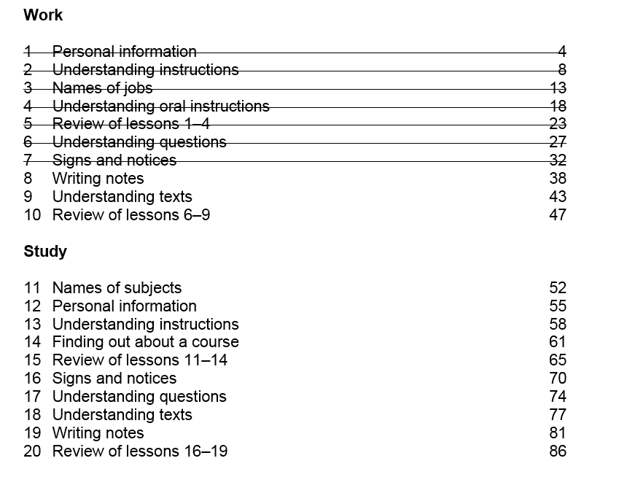

Slide 3
Unit 10 -Homework Task – Writing (50 words)
Unusual jobs

Slide 4


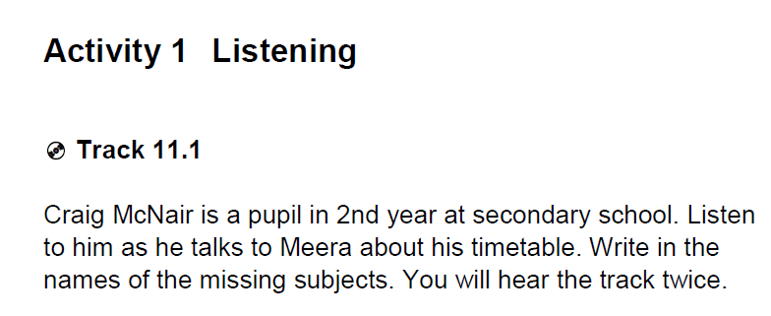
Unit 11 - Study

Slide 5
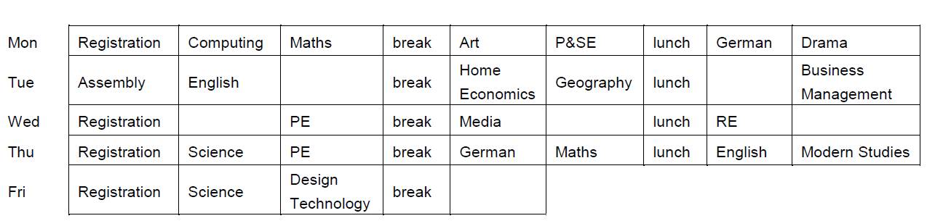
Science
Maths
German
English
History
Music

Slide 6
Activity 2 – Speaking - Past Tense / Future Tense
Work with a partner and try to talk for 2-3 minutes
If you are working -
1 Discuss the subjects you studied at school (Maths, Chemistry, Art…)
2 (a) Which were your favourites?
(b) Which did you not like?
3 Are you studying at the moment?
4 Which courses do you want to do in the future?

Slide 7
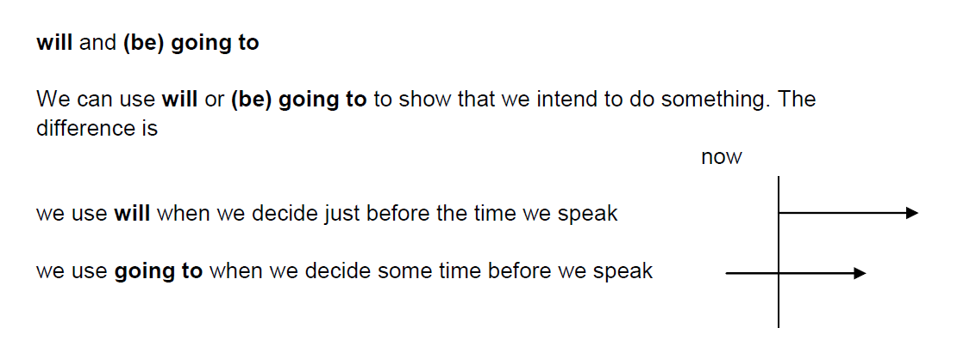
Activity 3 – Grammar

Slide 8
Activity 3 – Grammar

Slide 9
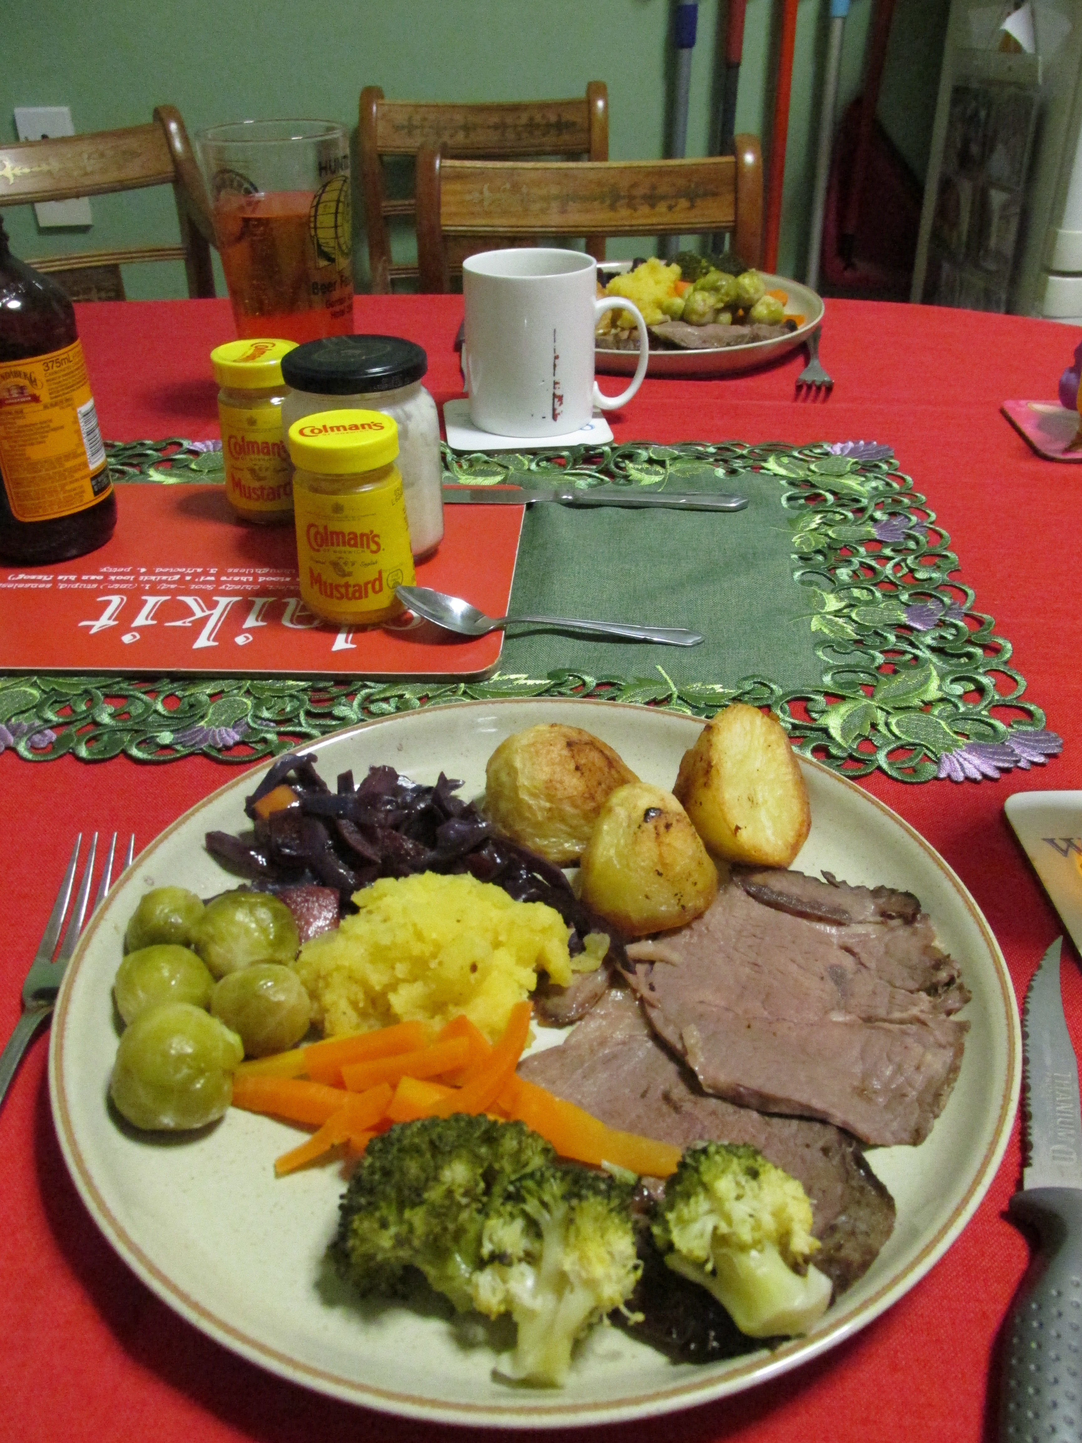

Slide 10
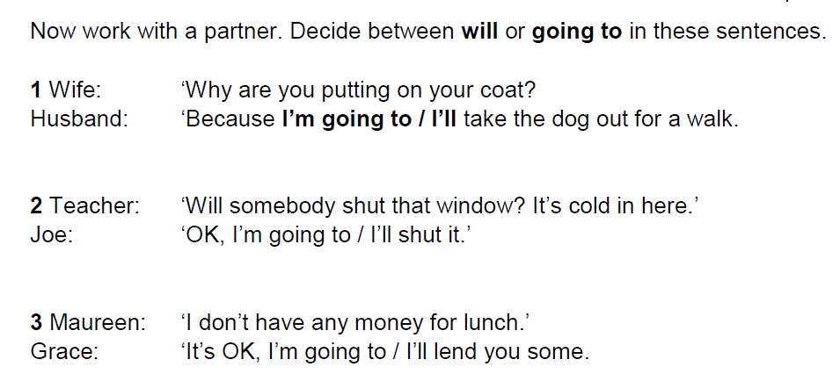
Activity 3 – Grammar

Slide 11
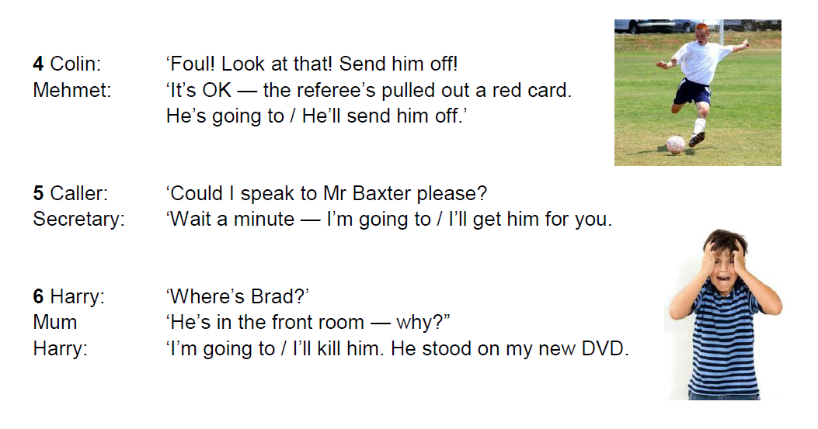

Activity 3 – Grammar

Slide 12
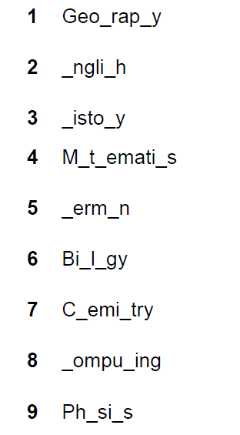


Activity 4 – Vocabulary

Slide 13
Activity 4 – Vocabulary
1 Geography
2 English
3 History
4 Mathematics
5 German
6 Biology
7 Chemistry
8 Computing
9 Physics
10 Drama

Slide 14
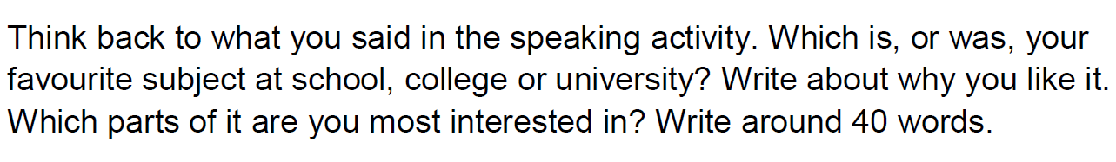
Activity 5 - Writing

Slide 15
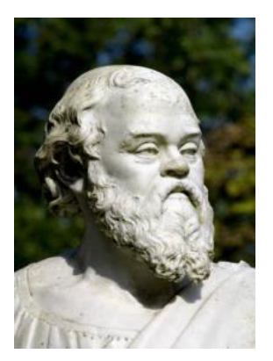
Homework Task
Think about another country. Are there any subjects in the schools there which are not studied in Scottish schools?
© istockphoto.com Hans Laubel

Slide 16
Thank you
Slides created by Aberdeenshire Council Community Learning and Development Team.
© Scottish Qualifications Authority 2007
Please note these materials have been repurposed for the new National Qualifications - August 2015
Image Credits © istockphoto/ or © Avril Morrison as indicated.
https://www.sqa.org.uk/sqa/33695.html

Slide 17
Thank you
Community Learning
and Development

